Slide 1
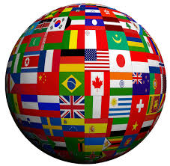
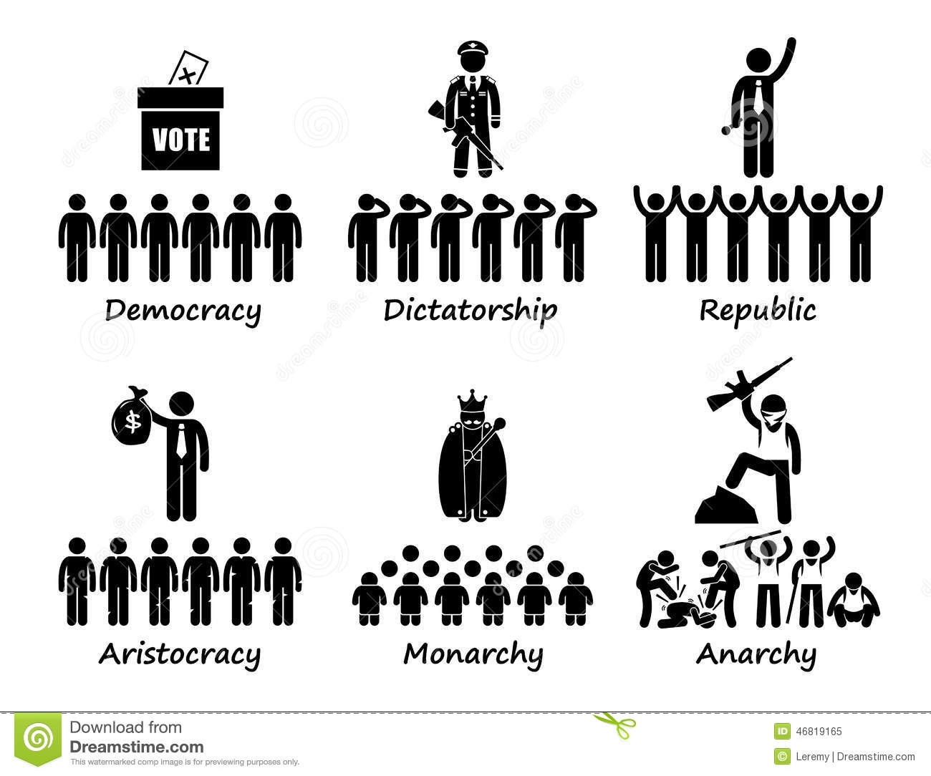
Types of governments

Slide 2
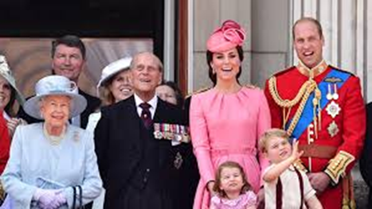
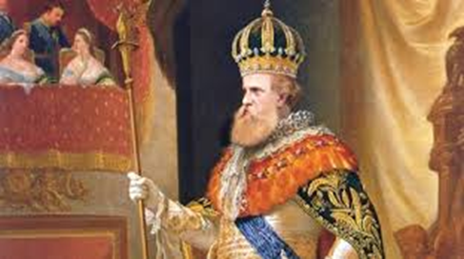
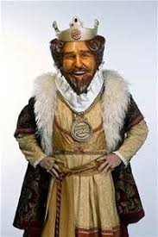
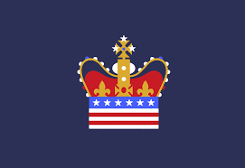
Monarchy
In a monarchy, a king or queen rules the country. The king or queen is known as a monarch and comes to power through their family line. England is a monarchy.

Slide 3
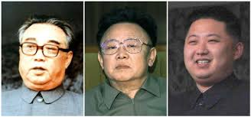
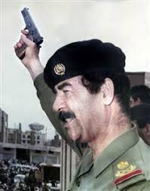
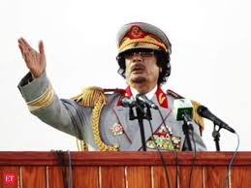
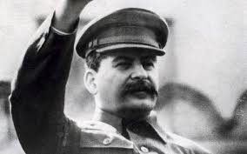
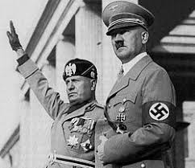
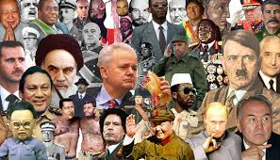
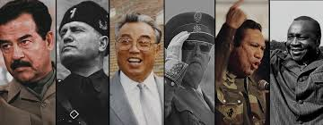
Dictatorship
A dictatorship is a form of government where one leader has absolute control over citizens’ lives. Nazi Germany was a dictatorship under Adolf Hitler.

Slide 4
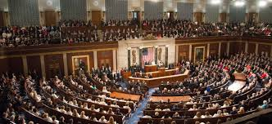
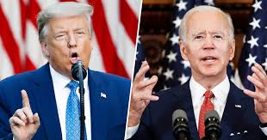
Representative Democracy
In a representative democracy, citizens elect leaders to represent their rights and interests in government. An example of this is the United States.

Slide 5
Direct Democracy
In a direct democracy, there are no representatives. Citizens are directly involved in the day-to-day work of governing the country. Ancient Athens used a direct democracy.

Slide 6
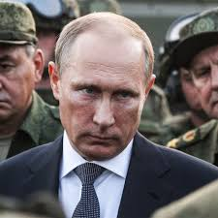
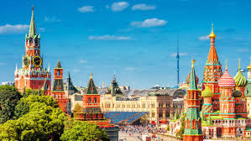
Oligarchy
In an oligarchy, similar to an aristocracy, a small group of people have all the power. Russia is an example of an oligarchy ruled that way since the 1400’s. Putin is part of the oligarchy were Russian billionaires buy influence in the government.

Slide 7
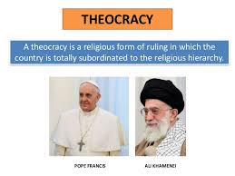
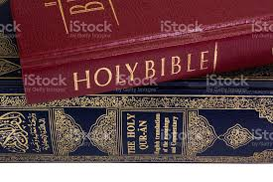
Theocracy
A theocracy is a government that recognizes God or a divine being as the ultimate authority and uses religious law is to settle disputes and rule the people. Iran is an example of a theocracy.

Slide 8
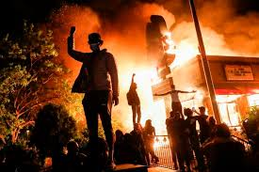
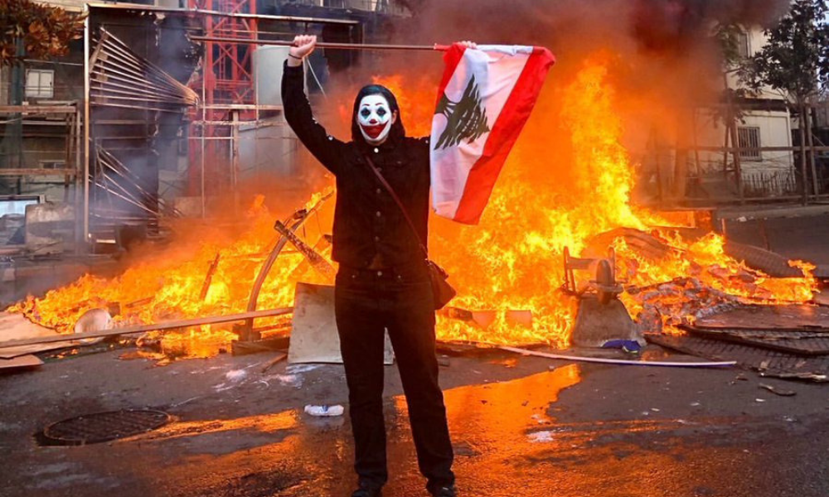
Anarchy
In an anarchy, nobody is in control—or everyone is, depending on how you look at it. There are no countries that have anarchy as their form of government.

