Slide 1
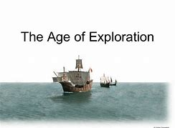
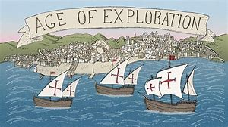
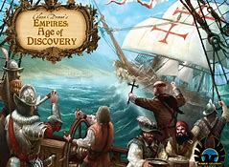
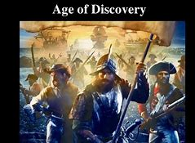
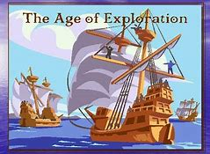
Age of Exploration

Slide 2
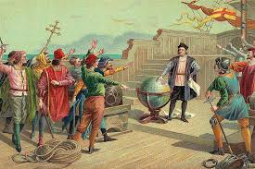
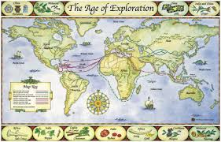
The Renaissance contributed to the Age of Exploration by awakening a spirit of discovery and innovation in Europe

Slide 3
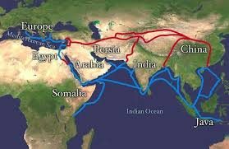
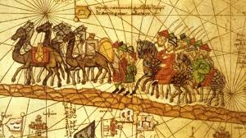
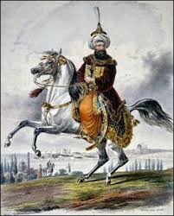
Muslims had a monopoly over trade routes and only traded with Italy, thereby blocking the rest of Europe from trading directly with Asia

Slide 4
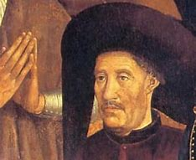
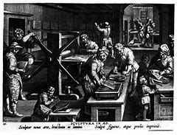
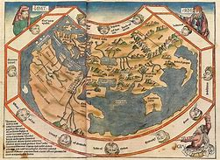
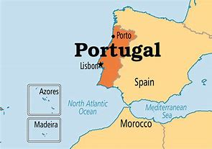
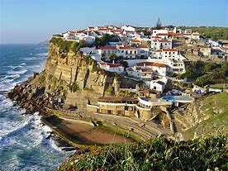
Portugal-1st European country to explore the world
Prince Henry the Navigator started a school for navigators, helping to advance map making by using the printing press.

Slide 5
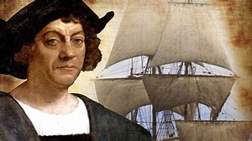
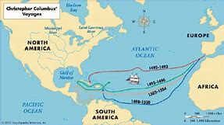
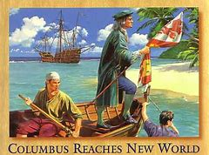
Christopher Columbus set sail west to discover Asia and instead landed in the New World/West Indies

Slide 6
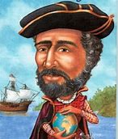
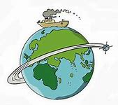
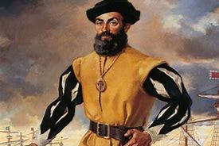
Circumnavigate-to circle something completely
Ferdinand Magellan was the first sailor to have his ships circumnavigate the entire world

Slide 7
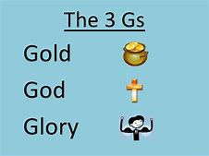
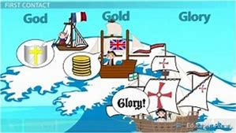
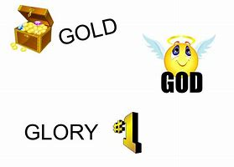
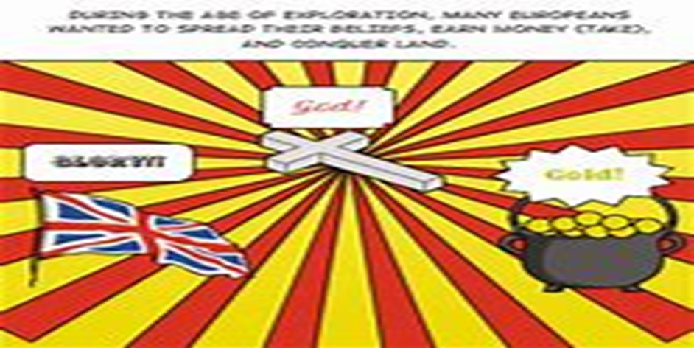
God, Gold and Glory were the 3 main reasons people wanted to explore the world

Slide 8
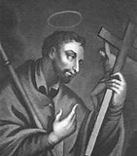
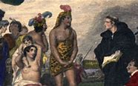
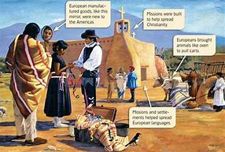
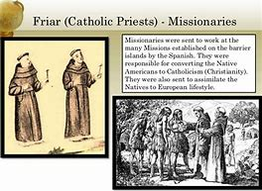
Europeans who wanted to spread the word of God and messages of Christianity were called missionaries

Slide 9
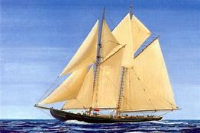
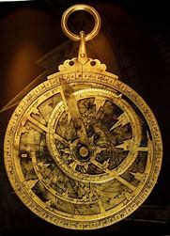
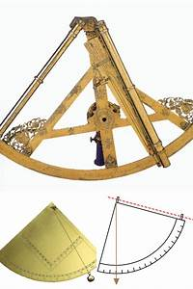
Astrolabe= found longitude by studying the position of the stars and planets
The development of new and improved navigational technology helped explorers navigate the oceans.

Slide 10
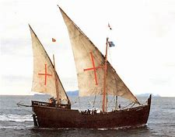
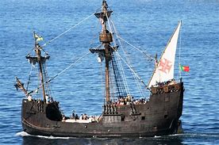
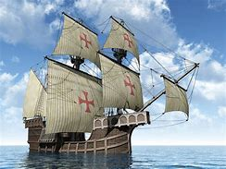
A caravel is a small, highly maneuverable sailing ship developed in the 15th century by the Portuguese to explore along the West African coast and into the Atlantic Ocean

Slide 11
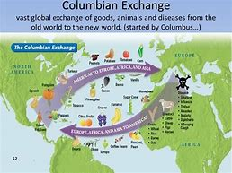
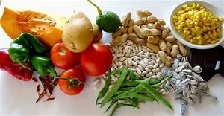
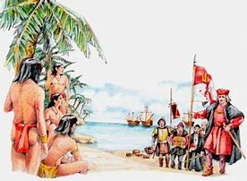
The exchange of Goods, diseases, ideas, people, plants and animals made a big impact on people’s lives
New crops, such as potatoes and turkeys, became included in the European diet during the Colombian Exchange

Slide 12
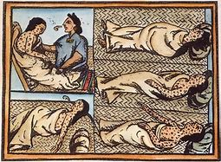
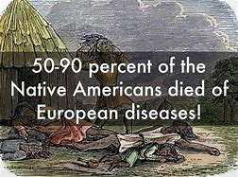
The Natives were not immune to the diseases brought over by Europeans and millions of Natives died.

Slide 13
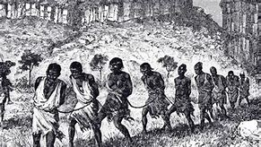
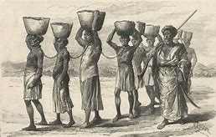
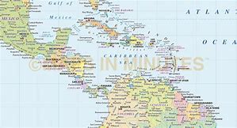
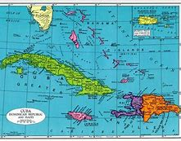
Most enslaved Africans were sent to the Caribbean and Spanish America.

Slide 14
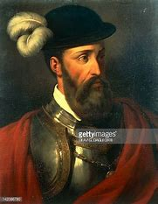
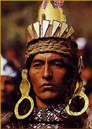
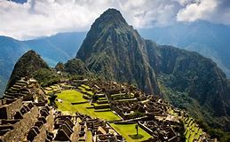
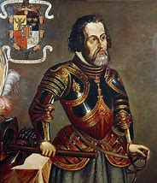
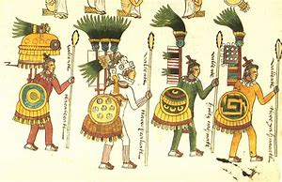
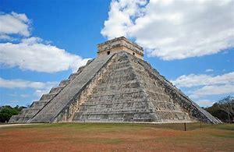
Hernan Cortez and Francisco Pizzaro were both conquistadors who destroyed the Aztec and Inca empires

Slide 15
Portugal colonized Brazil and Spain colonized the rest of South America.
Portugal was the first to bring slaves over to the New World, specifically Brazil

Slide 16
Africa to the Americas that was part of the Triangle Trade was also known as the "Middle Passage

Slide 17
Most slave forts were located on Africa’s west coast.

