Slide 1



Slide 2

As explorers traveled around the world bringing new ideas and technology, people began to question the ideas of the ancient Greek and Roman scholars.

Slide 3

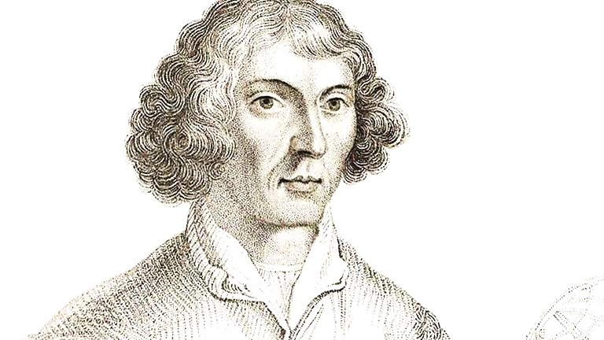
The Scientific Revolution began with the publishing of the book, On the Revolution of the Celestial Spheres, by Nicolas Copernicus.
Copernicus was the first to theorize the heliocentric theory - that the earth revolved around the sun.

Slide 4


Tycho Brahe was one of the first scientists to record the position of the stars. He emphasized the idea of careful observation and data.
Johannes Kepler also made advances in astronomy by mapping the orbits of planets.
Kepler stated that planets orbit in an elliptical shape, advancing on Copernicus’ initial theory.

Slide 5
Galileo Galilei was the first person to study the sky using a telescope.
He discovered the craters and mountains on the moon as well as the moons orbiting Jupiter.
First scientist to routinely use experiments to test his theories.
Galileo’s teachings along with others conflicted with the Catholic Church.
Galileo was put on trial for heresy and forced to take back his theories in fear of being tortured.
This clash helped spark more questioning about science and society.

Slide 6

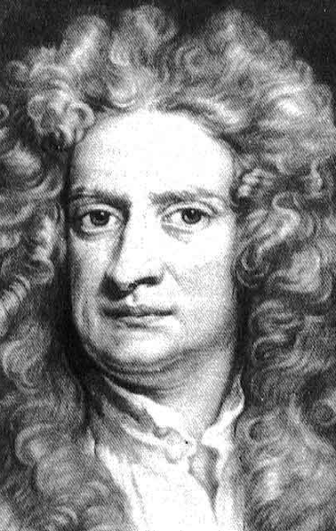
Sir Isaac Newton was an English scientist who wrote the book, Principa Mathematica.
Newton invented calculus.
Newton introduced the law of gravity which stated that force attracts objects to one another.
Newton also created the laws of motion which describes how objects move through space.
He stated, “For every action there is an equal and opposite reaction.”

Slide 7


During the Scientific Revolution new inventions led to new discoveries and theories.
Galileo invented the thermometer, an instrument that measures temperature.
Torricelli invented the barometer, an instrument that measures air pressure (this helps predict the weather).

Slide 8
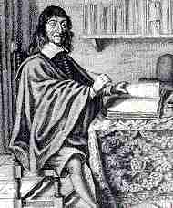
As the Scientific Revolution progressed, science became the center of knowledge.
Francis Bacon argued that science should be pursued systematically (step-by-step) to gain more knowledge.
Rene Descartes argued that nothing should be accepted as true unless proven.
Descartes claimed that knowledge began with doubt, not faith.

Slide 9

The scientific method is a step-by-step method for conducting research.
1. Stating the problem. Asking why?
2. Collecting information.
3. Forming a hypothesis: an educated guess as to what may happen.
4. Testing the hypothesis.
5. Recording and analyzing data.
6. Creating conclusions on the research and data.

Slide 10

“If you would be a real seeker after truth, it is necessary that at least once in your life you doubt, as far as possible, all things.”
Descartes

Slide 11
“To every action there is always opposed an equal reaction.”
Newton.

Slide 12
“Therefore, when I considered this carefully, the contempt which I had to fear because of the novelty and apparent absurdity of my view, nearly induced me to abandon utterly the work I had begun.”
Copernicus.

Slide 13
“The Bible shows the way to go to heaven, not the way the heavens go.”
“The sun, with all those planets revolving around it and dependent on it, can still ripen a bunch of grapes as if it had nothing else in the universe to do.”
Galileo

