Slide 1
Imperialism

Slide 2
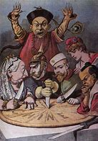
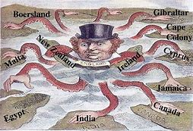
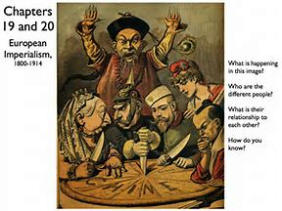
Britain, France, Italy, Belgium, and Germany played a key role in the New Imperialism.

Slide 3
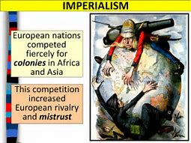
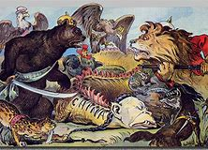
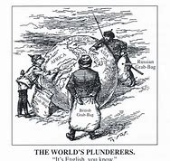
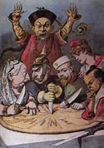
Industrial nations competed for control of natural resources and power.

Slide 4
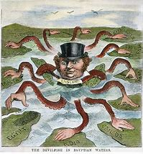
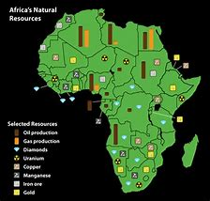
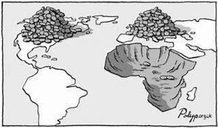
Europeans wanted to take over others lands for natural resources for their industries and new markets to sell products.

Slide 5
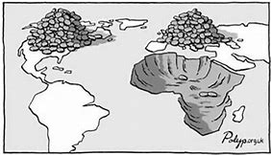
Foreigners used the most fertile land and took wealth out of the countries they controlled.

Slide 6
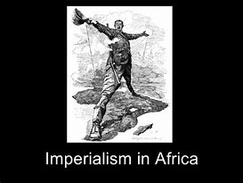
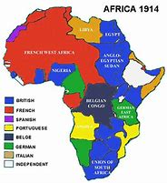
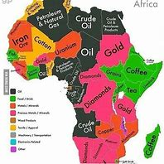
Foreigners took the most fertile land in Africa and took wealth out of the countries.

Slide 7
In the 1900’s, Africa was mostly made up of European colonies.

Slide 8
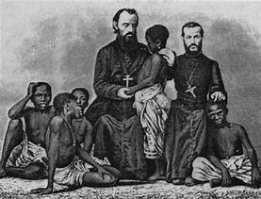
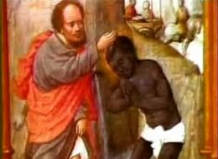
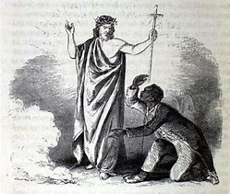
One objective of 19th century European imperialism was to convert natives to Christianity.

Slide 9
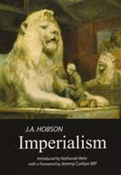
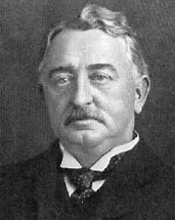
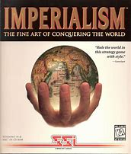
Cecil Rhodes believed that European imperialism benefitted people of all cultures throughout the world.

Slide 10
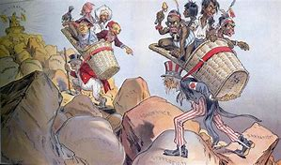
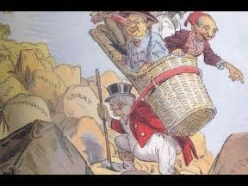
The term “white man’s burden” reflects the idea that Europeans had a responsibility to improve the lives of the people they colonized.

Slide 11
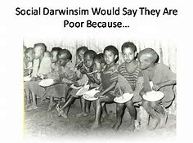
Social Darwinism is the theory of survival of the fittest applied to societies.

Slide 12
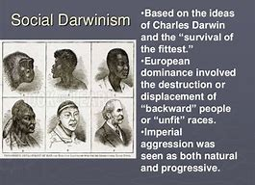
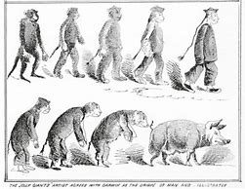
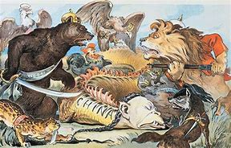
Some Europeans, during the Age of Imperialism, thought people of color were less than human.

Slide 13
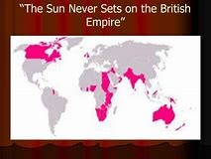
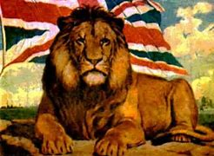
“The sun never set on the British Empire” means that the Empire was so extensive that there was always at least one part of their territory that was in daylight.

Slide 14
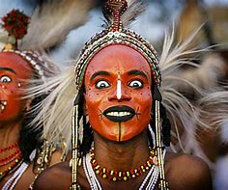
The tribal governments of Africa weakened as a result of European imperialism in the 19th century and therefore lost political independence.

Slide 15
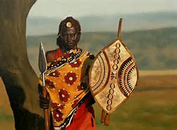
African cultural and ethnic traditions were often ignored by colonial governments.

Slide 16
Most Africans thought that they could take care of themselves without European help.

Slide 17
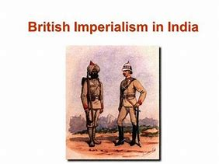
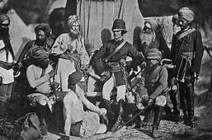
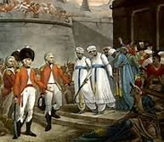
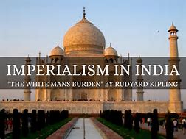
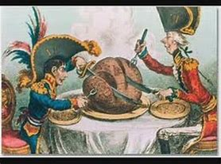
Europeans thought that imperialism in India helped the people by advancing and modernizing their governmental institutions.

Slide 18
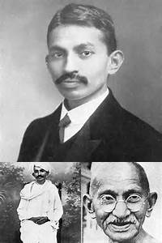
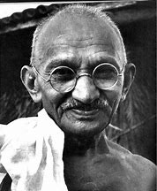
Gandhi used civil disobedience to achieve independence from Great Britain.

Slide 19
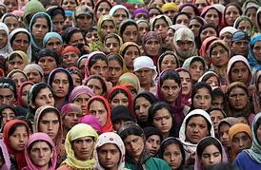
Differences in language and religion prevented unity among the people of India.

Slide 20
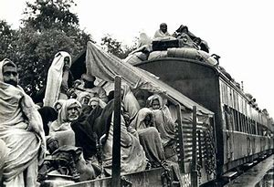
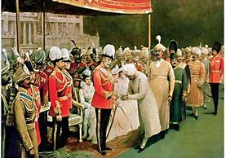
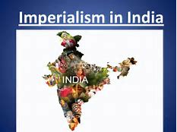
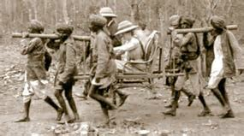
Britain helped the Indians to strengthen its political and economic control in India.

Slide 21
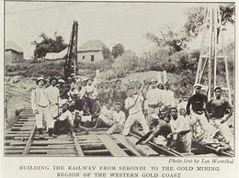
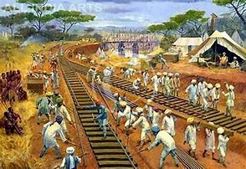
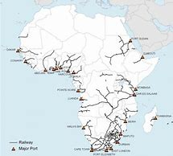
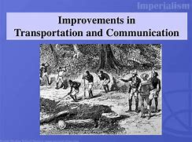
Improved transportation and communication systems were a major effect of European rule in Africa.

Slide 22
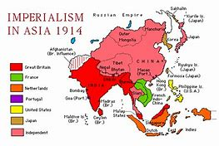
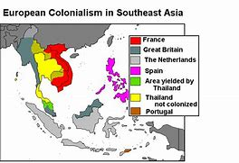
Europeans were successful in dominating military and commercial relations with Asia.

Slide 23
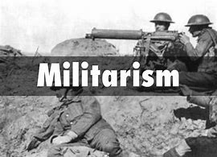
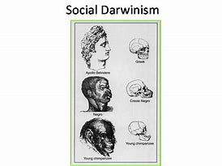
Militarism, Industrialization, Nationalism, Religion, and Social Darwinism were the main causes of New Imperialism.

