Slide 1
Industrial Revolution

Slide 2
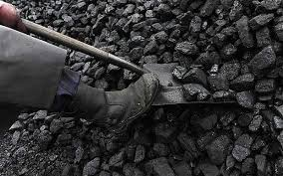
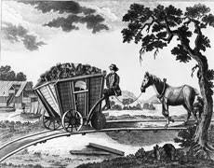
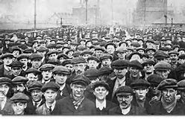
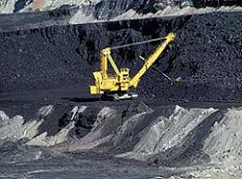
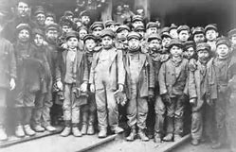
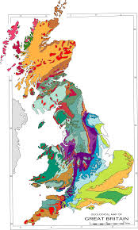
Because there was a large supply of human and natural resources in Great Britain the Industrial Revolution began there.

Slide 3
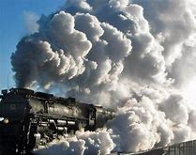
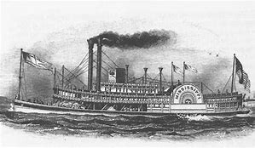
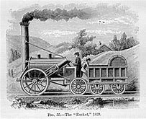
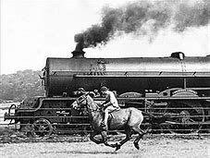
Steam was a new power source from that led to changes in transportation

Slide 4
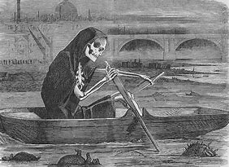
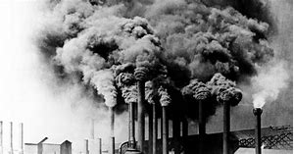
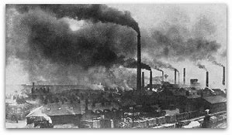
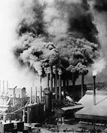
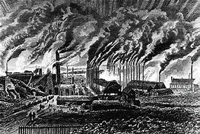
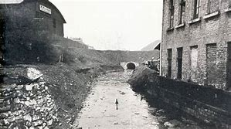
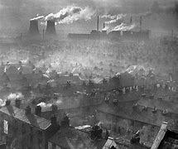
Pollution was a problem during the Industrial Revolution..

Slide 5
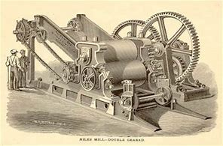
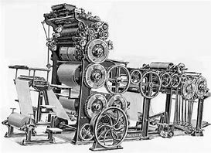
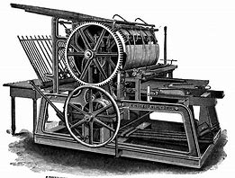
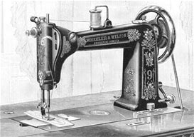
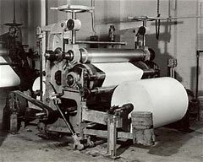
To increase production output businesses used machines to mass produce.

Slide 6
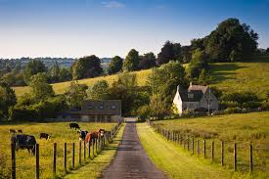
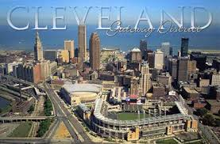
Many people during the Industrial Revolution moved from rural areas to urban areas.

Slide 7
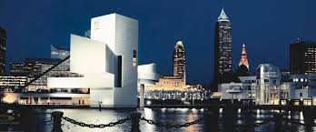
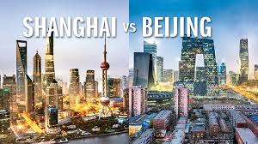
Urbanization is the moving of people from rural or country areas to urban or city areas.

Slide 8
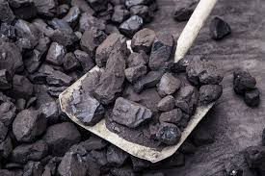
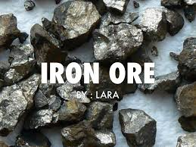
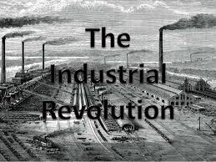
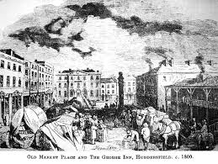
Sufficient coal and iron ore reserves and a good transportation system was a major reason that the Industrial Revolution began in Great Britain

Slide 9
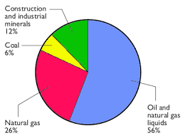
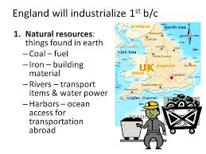
England's natural resources led to the growth of industrial cities.

Slide 10
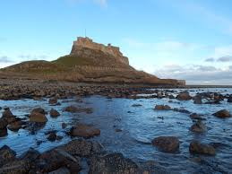
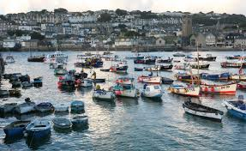
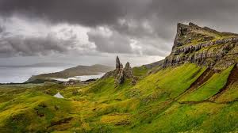
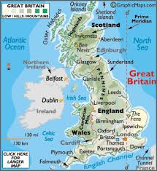
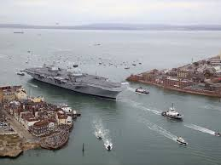
A major reason the Industrial Revolution developed in Great Britain in the 1700s was because of Great Britain's geographic features

Slide 11
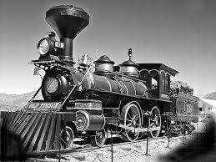
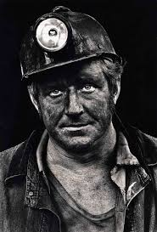
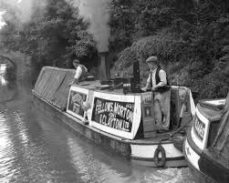
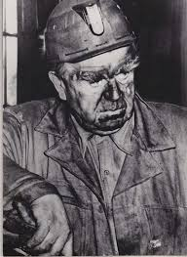
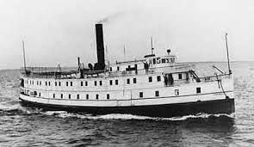
Coal and iron ore were used to change transportation and manufacturing in Great Britain during the Industrial Revolution

Slide 12
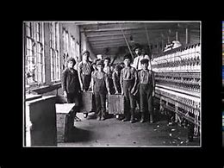
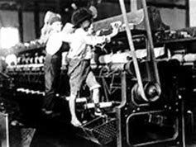
One of the long-term after-effects of the Industrial Revolution in Europe was a general rise in the standard of living.

Slide 13
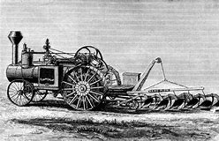
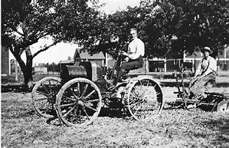
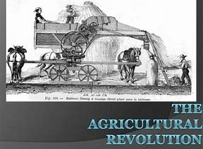
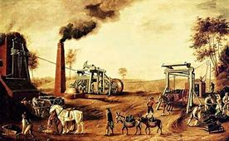
The Agricultural Revolution was essential as a foundation for the Industrial Revolution by providing machines for use in factories.

Slide 14
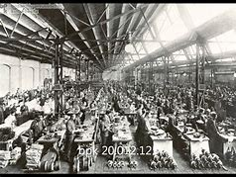
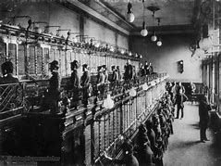
Industrialization means that manufactured goods are being produced in factories

Slide 15
In the early stages of the Industrial Revolution in Europe, one change was the population of cities grew rapidly

Slide 16
The invention of spinning and weaving machinery increased the number of workers in the textile industry because the demands for goods grew as they became cheaper to produce

Slide 17
The textile industry was the first industry to be transformed by mechanization because cloth-making was very laborious and time-consuming.

Slide 18
Humans changed the landscape by building many factories that polluted the air and environment.

Slide 19
Working-class families depended on the earnings of all their members to survive

Slide 20
Steam engines were a reliable energy source during the Industrial Revolution

Slide 21
Children were physically damaged by work they did in the factories.

Slide 22
A tenement is an overcrowded slum apartment building that provided new housing that was needed to provide for the massive amounts of people that moved into the cities to find work.

