Slide 1
Inventions of the Industrial Revolution

Slide 2
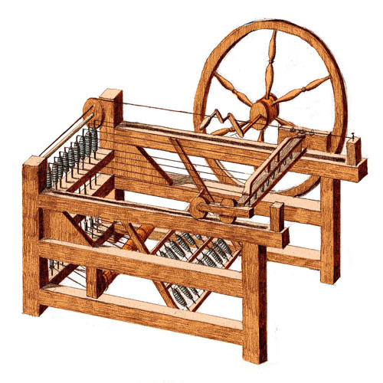
The Spinning Jenny- 1764
Invented by James Hargreaves in 1764, the spinning jenny was a wooden machine that spun several threads at once, instead of only one thread like the old spinning wheel.
The spinning jenny helped to increase the production of thread and put some people out of jobs because it could do the work of several people at once.

Slide 3
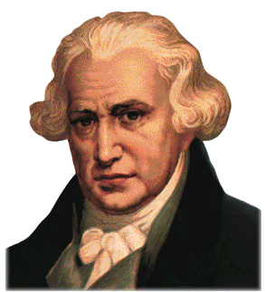
The Steam Engine- 1765
Invented by James Watt in 1765, the Steam Engine used energy from steam to move large machinery.
The Steam Engine provided a convenient source of energy for major forms of transportation. The steam engine allowed for quicker transportation of raw materials.

Slide 4
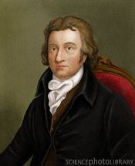
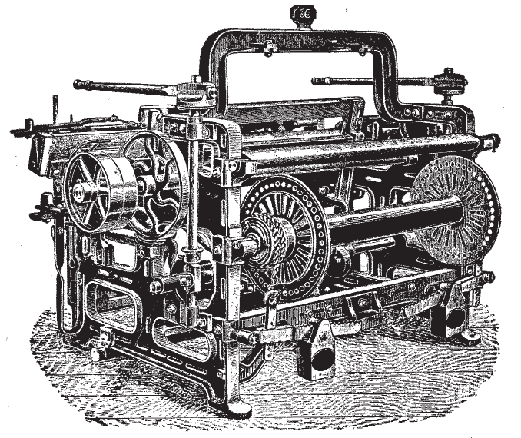
The Power Loom- 1784
Invented by Edmund Cartwright in 1784, this machine weaved fabric together more quickly and required less people to do the job.
The power loom improved the speed and quality of weaving cloth.

Slide 5
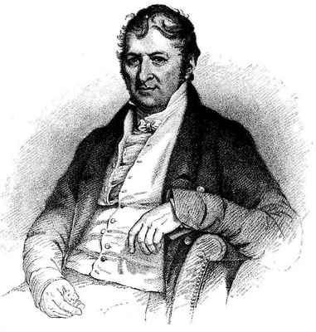
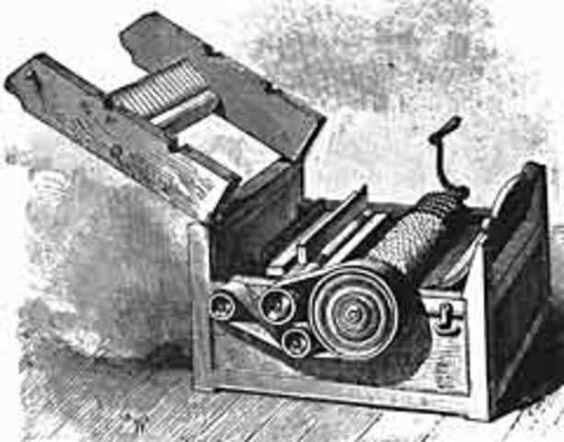
The Cotton Gin- 1793
The Cotton Gin was invented by Eli Whitney in 1793, this machine separated the cotton seed from the cotton itself.
The cotton gin processed cotton faster, which meant that more cotton was needed for the gin. This increased the need for slaves picking cotton in the American South.

Slide 6
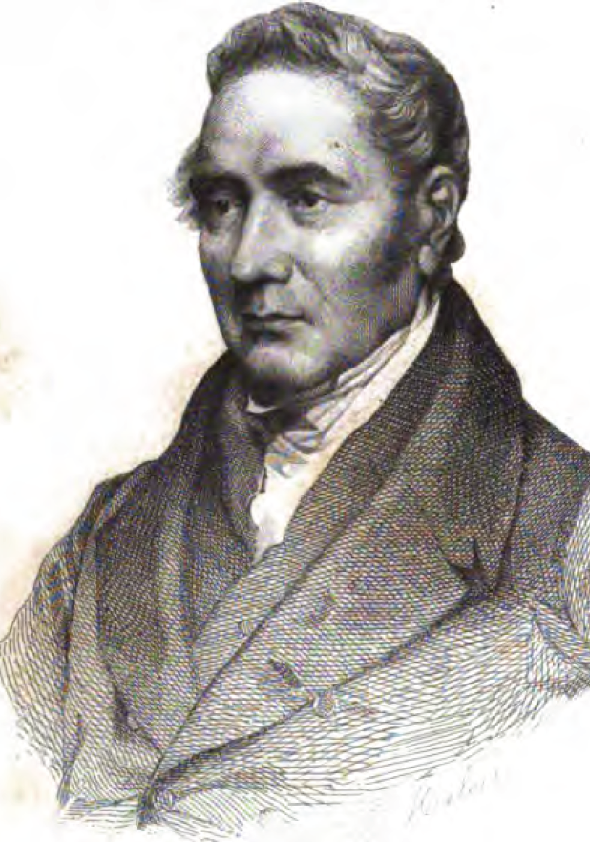
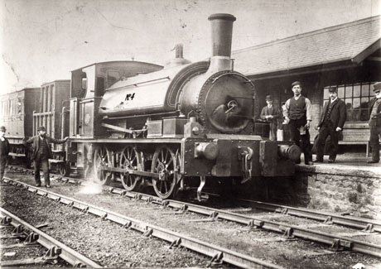
The Locomotive- early 1800s
In the early 1800s, George Stephenson invented the locomotive. The locomotive’s purpose was to move a self-propelled train along the railroad.
The locomotive provided better transportation—it was quick and inexpensive. Merchants were now able to ship goods to places further away. This meant that more goods needed to be produced since more people could purchase the goods.

