Slide 2
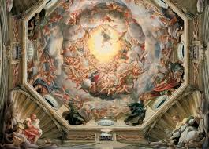
The term "Renaissance" means Rebirth

Slide 3
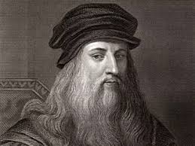
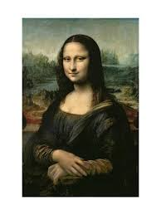
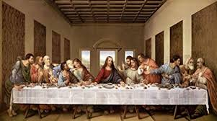
The Mona Lisa and The Last Supper were two famous paintings by Leonardo da Vinci

Slide 4
European society during the Renaissance differed from society during the Middle Ages in that during the Renaissance the emphasis on a human's self-worth increased

Slide 5
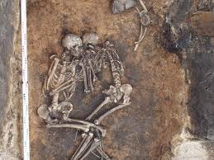
The Bubonic Plague led to a period of rebirth, called the Renaissance.

Slide 6
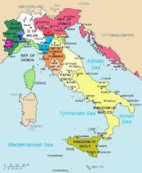
The Italian city-states, especially in the north, were wealthy centers of trade

Slide 7
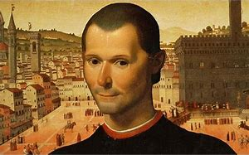
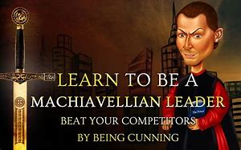
Leaders should do whatever is necessary to achieve their goals was an idea about leadership that Machiavelli would agree with

Slide 8
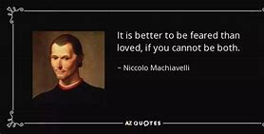
Machiavelli's opinion of mankind and human nature was that It is better to be feared than to be loved.

Slide 9
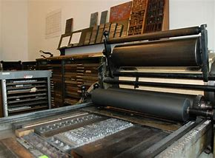
In Europe, a long term effect of the invention of the printing press was that the literacy rates increased… The Bible was the most popular book

Slide 10
Increasing numbers of people learned to read during the Renaissance because printed books became more available and cheaper to buy.

Slide 11
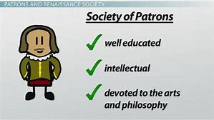
A patron is a person who supports the arts

Slide 12
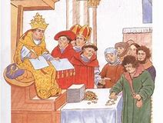
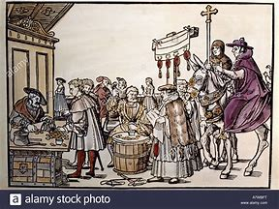
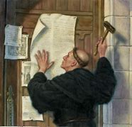
An official church pardon that relieved Catholics from punishment for sins is called an indulgence….Luther complained about it in his 95 Thesis

Slide 13
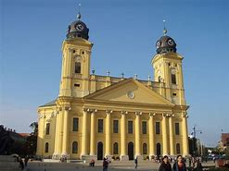
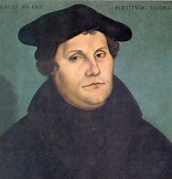
A Christian who separated from the Catholic Church during the Reformation was called a Protestant

Slide 14
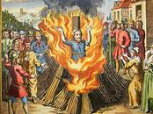
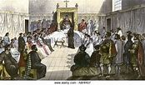
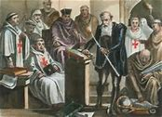
Holding religious beliefs that contradict (go against) the teachings of the Church is called heresy

Slide 15
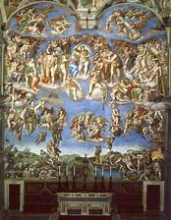
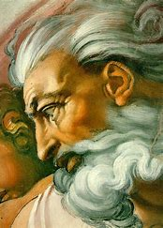
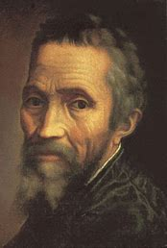
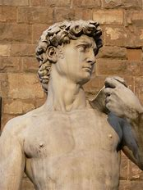
Michelangelo sculpted David and also painted the ceiling of the Sistine Chapel

Slide 16
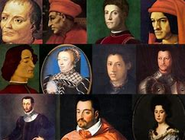
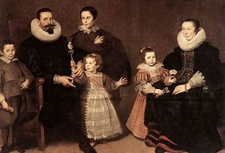
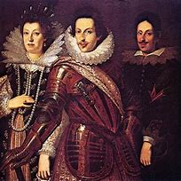
The Medici Family were well-known bankers and were very important to the Renaissance because they were patrons to many famous Renaissance artists

Slide 17
Protestant Reformation and the European Renaissance both encouraged people to question tradition.

Slide 18
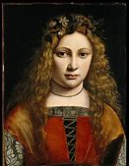
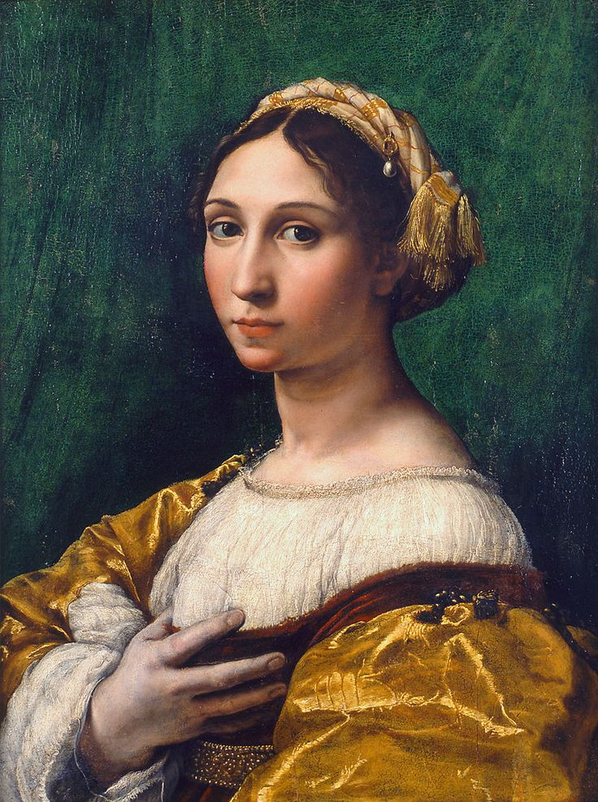
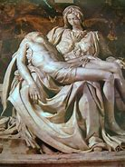
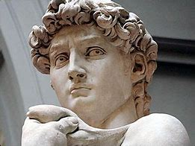
The people in Renaissance art were more realistic and life-like.

Slide 19
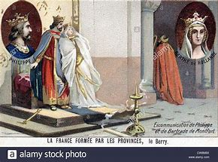
The official punishment for Martin Luther after he spoke out against the Catholic Church was excommunication from the Church.

Slide 20
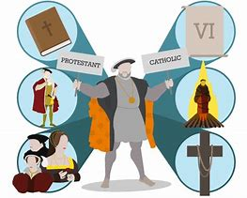
A major result of the Reformation in Europe a split between Catholics and Protestants

Slide 21
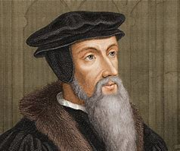
John Calvin taught his followers the idea of predestination

Slide 22
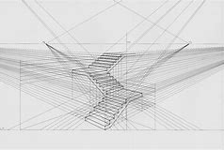
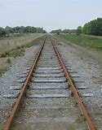
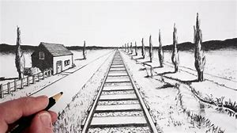
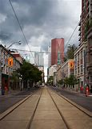
Perspective was a popular art method used during the Renaissance that showed a 3-d scene on a flat surface, in order to make the painting realistic.

