Slide 1
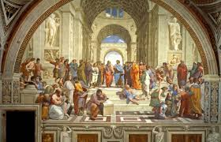
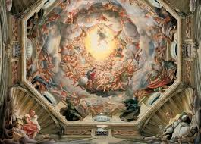
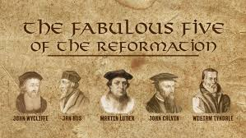
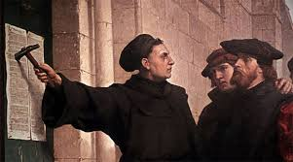
Renaissance and the Reformation

Slide 2
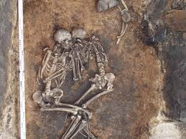
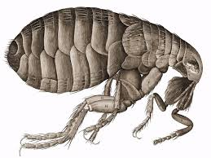
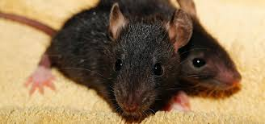
The Bubonic Plague led to a period of rebirth, called the Renaissance.

Slide 3
The term "Renaissance" means Rebirth

Slide 4
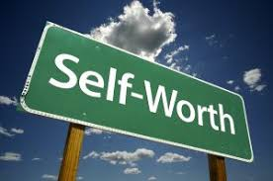
European society during the Renaissance differed from society during the Middle Ages in that during the Renaissance the emphasis on a human's self-worth increased

Slide 5
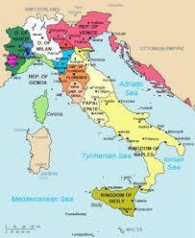
The Italian city-states, especially in the north, were wealthy centers of trade

Slide 6
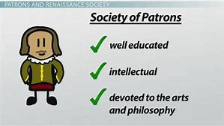
A patron is a person who supports the arts

Slide 7
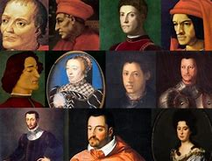
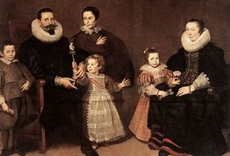
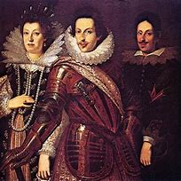
The Medici Family were well-known bankers and were very important to the Renaissance because they were patrons to many famous Renaissance artists

Slide 8
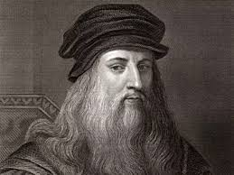
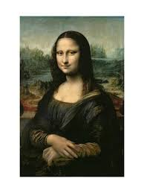
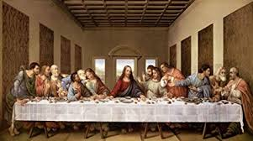
The Mona Lisa and The Last Supper were two famous paintings by Leonardo da Vinci

Slide 9
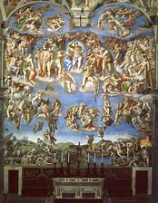
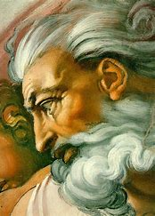
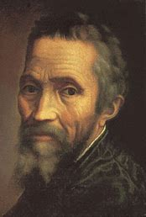
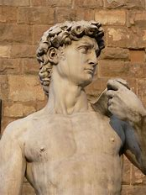
Michelangelo sculpted David and also painted the ceiling of the Sistine Chapel

Slide 10
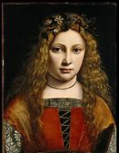
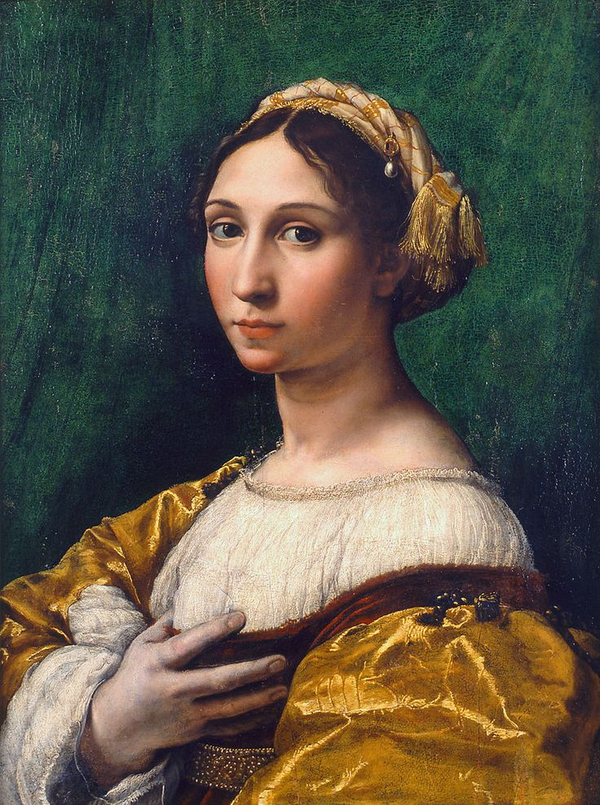
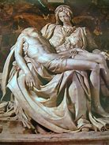
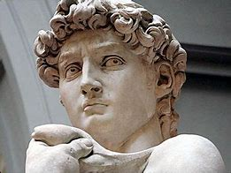
The people in Renaissance art were more realistic and life-like.

Slide 11
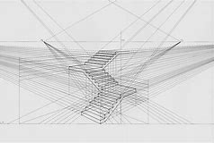
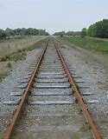
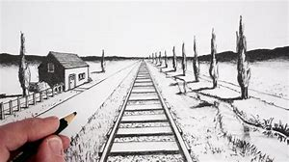
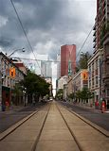
Perspective was a popular art method used during the Renaissance that showed a 3-d scene on a flat surface, in order to make the painting realistic.

Slide 12
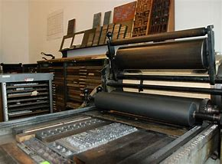
In Europe, a long term effect of the invention of the printing press was that the literacy rates increased… The Bible was the most popular book

Slide 13
Increasing numbers of people learned to read during the Renaissance because printed books became more available and cheaper to buy.

Slide 14
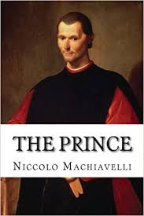
Machiavelli wrote a book called the Prince

Slide 15
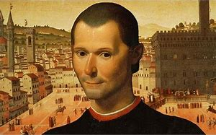
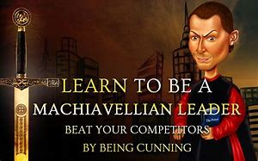
Leaders should do whatever is necessary to achieve their goals was an idea about leadership that Machiavelli would agree with

Slide 16
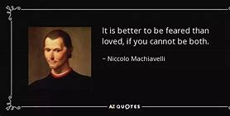
Machiavelli's opinion of mankind and human nature was that It is better to be feared than to be loved.

Slide 17
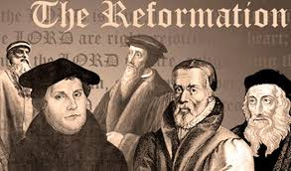
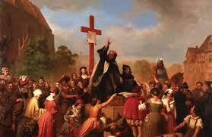
Reformation

Slide 18
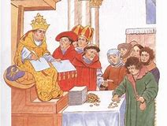
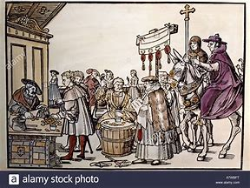
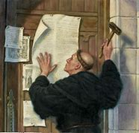
An official church pardon that relieved Catholics from punishment for sins is called an indulgence….Luther complained about it in his 95 Thesis

Slide 19
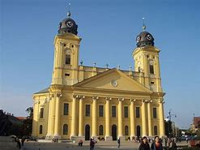
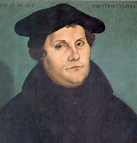
A Christian who separated from the Catholic Church during the Reformation was called a Protestant

Slide 20
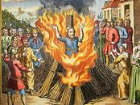
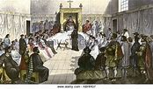
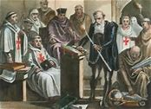
Holding religious beliefs that contradict (go against) the teachings of the Church is called heresy

Slide 21
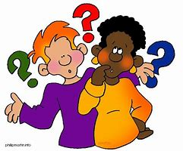
Protestant Reformation and the European Renaissance both encouraged people to question tradition.

Slide 22
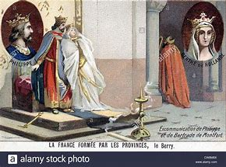
The official punishment for Martin Luther after he spoke out against the Catholic Church was excommunication from the Church.

Slide 23
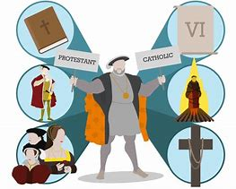
A major result of the Reformation in Europe a split between Catholics and Protestants

Slide 24
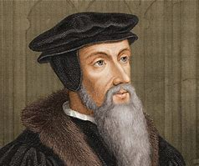
John Calvin taught his followers the idea of predestination

Slide 25
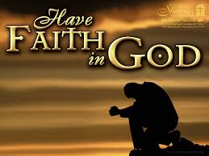
Martin Luther believed the key to salvation was faith in God.

Slide 26
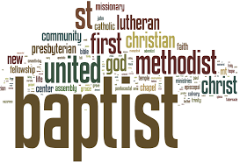
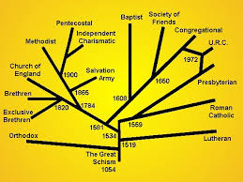
Because of the Protestant Reformation, new faiths and branches of Christianity were created.

Slide 27
An immediate effect of the Reformation in Western Europe was a decline in religious unity and the power of the Roman Catholic Church.

Slide 28
Henry VIII create the Church of England in order to divorce Catherine of Aragon and marry Anne Boleyn.

