Slide 1
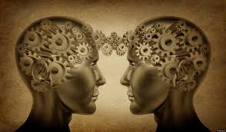
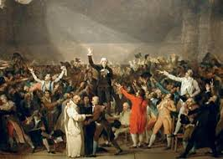
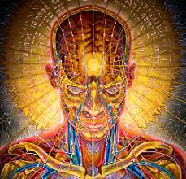
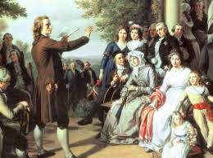
Review for Enlightenment test

Slide 2
John Locke argued that life, liberty, and property are natural rights that should be protected by the government.

Slide 3
John Locke inspired revolutions by arguing that a new social contract could be instituted if a government violated people’s natural rights.

Slide 4
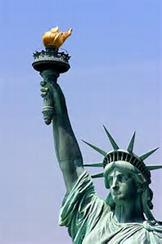
John Locke’s idea of life, liberty, and the right to own property was changed by the writers of the Declaration of Independence to life, liberty, and the pursuit of happiness.

Slide 5
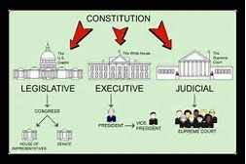
Natural rights, separation of powers, and political equality provided the basis for the establishment of democratic government.

Slide 6
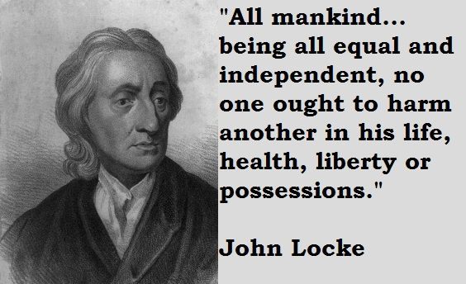
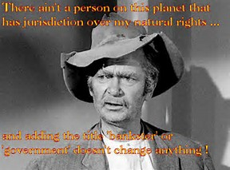
John Locke would agree that all human beings are born free and equal with a right to life and liberty. It is the duty of government to protect these natural rights of its citizens.

Slide 7
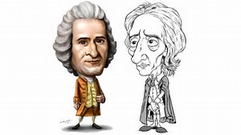
John Locke and Jean-Jacques Rousseau challenged the idea of the divine right of kings that led to revolutions to establish democratic governments

Slide 8
Revolution is defined as a nation’s fundamental change in its government, political system, and/or way of life.

Slide 9
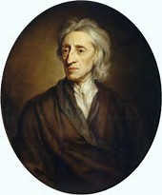
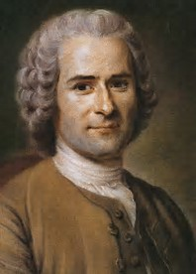
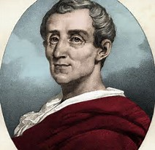
John Locke, Baron de Montesquieu, Jean-Jacques Rousseau, and Voltaire were European political thinkers who influenced the ideas of American leaders at the time of the Revolution.

Slide 10
The Scientific Revolution and the Enlightenment were similar because they encouraged the spread of new ideas.

Slide 11
The intellectual movement that stressed reason and logic to answer societal questions in government and life was known as The Enlightenment.

Slide 12
In a democracy the people create their own laws.

Slide 13
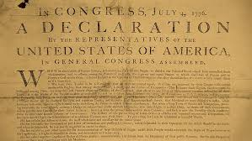
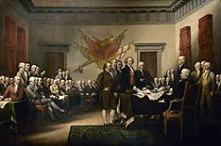
One goal of the Declaration of Independence was to explain why the colonists felt the need to be free from British rule.

Slide 14
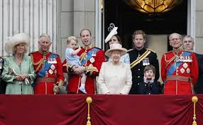
Colonists began to question the authority of the British monarchy.

Slide 15
. When Thomas Jefferson wrote, “All men are created equal,” he meant everyone should be entitled to the same rights.

Slide 16
It’s 2017 so we live in the 21st century. If you lived in 1231 you would live in the 13th century.

Slide 17
Colonists favored a representative government

Slide 18
Enlightenment thinkers supported movements for social and political change

Slide 19
When the war ended, England had to recognize the United States as a free and independent nation

Slide 20
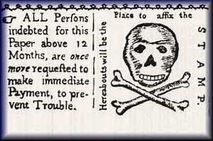
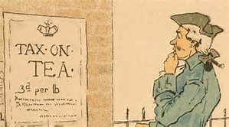
The Stamp Act, the Tea Act and the Intolerable Acts angered the colonists because they weren’t being represented.

Slide 21
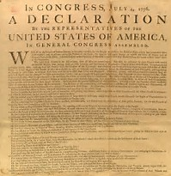
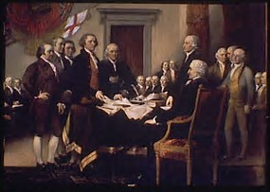
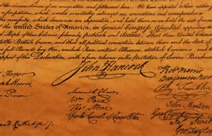
The United States Declaration of Independence emphasized the idea that government must protect the rights of the people.

Slide 22
New markets to sell their goods and resources in the colonies benefited England’s economy.

Slide 23
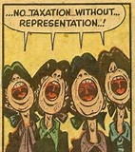
Colonists were not represented in the British Parliament and for that reason believed the taxes were unjust

