Slide 1
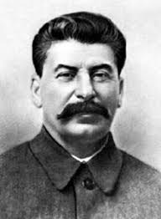
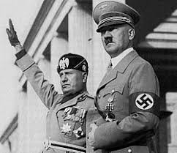
Rise of Dictators

Slide 2
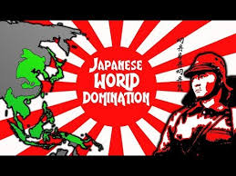
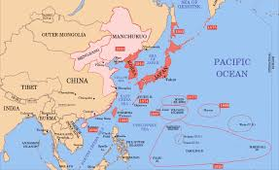

The imperialist policies adopted by Japan following World War I focused on acquiring markets for its oil industry.

Slide 3
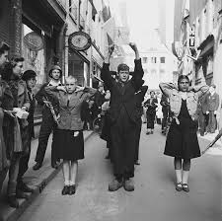
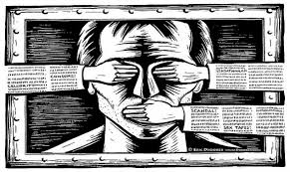
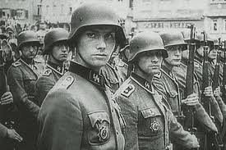
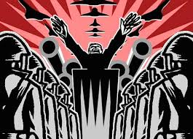
Censorship, mass arrests, and a secret police force are most characteristic of totalitarian regimes

Slide 4
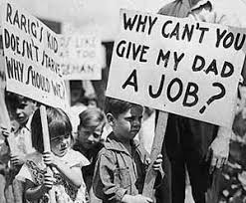
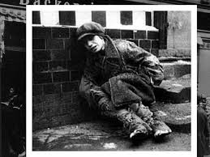
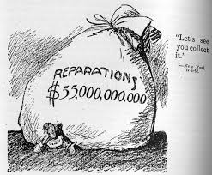
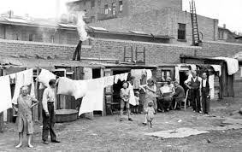
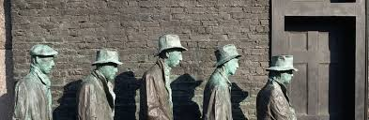
In the 1920's and 1930's, the rise of totalitarian governments in Germany, Italy, and the Soviet Union was largely the result of severe economic and social problems that arose in Europe after World War I.

Slide 5
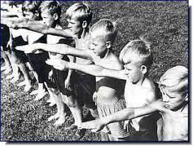
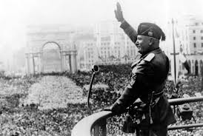
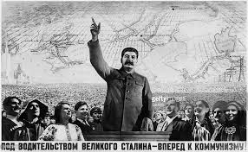
Fascist Italy, Nazi Germany, and Communist Russia were all one party systems that denied basic human rights

Slide 6
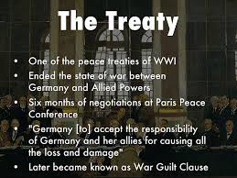
Germany accepted full responsibility for causing WWI.

Slide 7
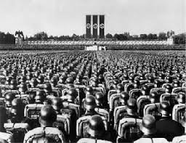
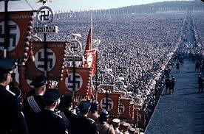
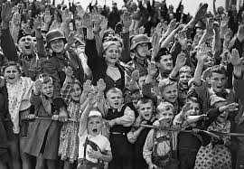
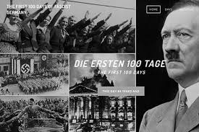
The harsh conditions imposed by the Treaty of Versailles after World War I laid the foundation for the rise of fascism in Germany.

Slide 8
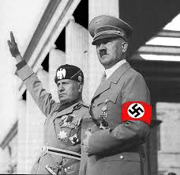
Fascist governments of Benito Mussolini and Adolf Hitler came to power in Italy and Germany because both nations faced economic and political difficulties.

Slide 9
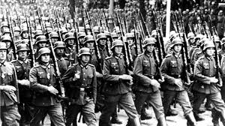
A major goal of France and Great Britain at the Paris Peace Conference following World War I was to keep Germany from rebuilding its military forces

Slide 10
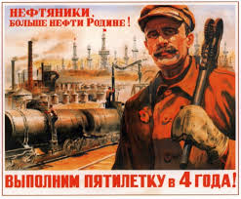
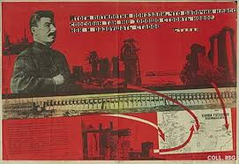
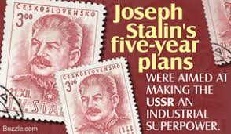
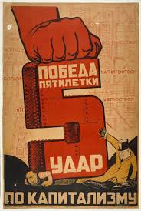
Encouraging rapid industrialization was the major goal of Joseph Stalin's five-year plans in the Soviet Union

Slide 11
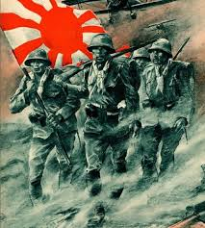
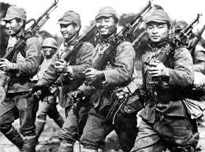
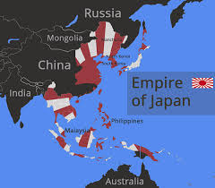
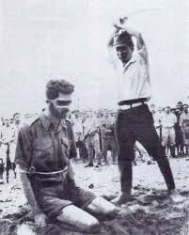
After World War I, Japan attempted to solve some of its economic problems by expanding its influence in Asia.

Slide 12
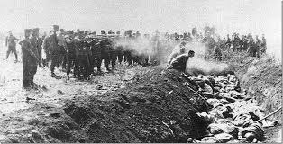
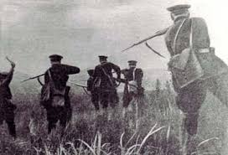
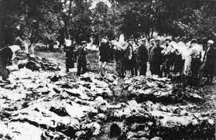
Stalin's "Great Purge" and reforms, from 1934 to 1939 brought about the death of millions of people

Slide 13
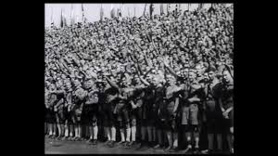
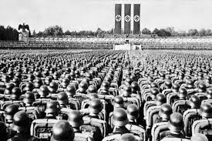
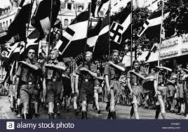
Fascist leaders in the 1920s and 1930s, gained popular support appealing to national pride

Slide 14
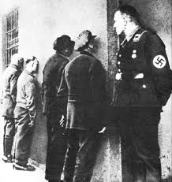
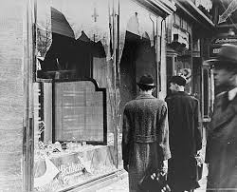
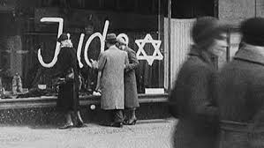
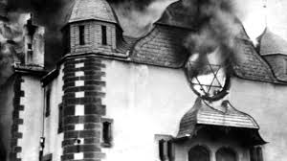
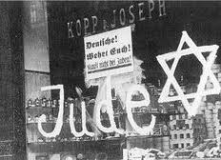
The Italian Fascist and the German Nazis gained power partly because they used terror tactics against political opponents.

Slide 15
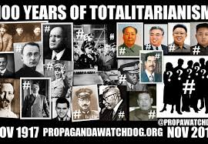
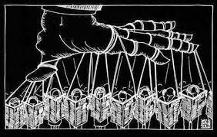
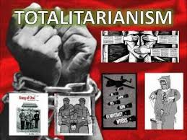
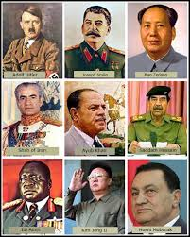
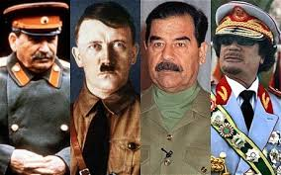
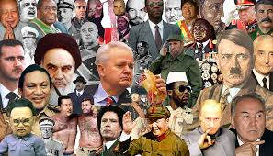
Totalitarianism and dictatorship mean the same thing

Slide 16
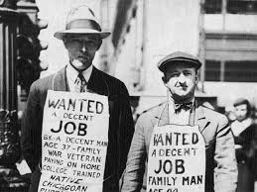
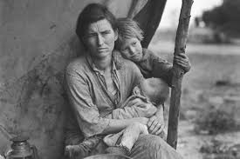


The Great Depression lasted from 1929 to 1939, and was the worst economic downturn in the history of the industrialized world.

Slide 17



Hitler
took control in Germany in large part because of the conditions in post-war Germany created by Treaty of Versailles.
ordered the mass executions of millions of Jews in his "Final Solution."
committed suicide in a Berlin bunker before the Allies could capture him.

Slide 18




Hitler used German resentment toward the Treaty of Versailles to gain power.

Slide 19





Under Adolf Hitler and the Soviet Union under Josef Stalin the governmental controlled of the media

Slide 20



Worsening economic conditions contributed to the rise of totalitarian governments in Europe

Slide 21



National and racial supremacy were used by the Nazis in Germany and Fascists in Italy

Slide 22


People may be willing to sacrifice liberty if economic security is promised.

Slide 23



A characteristic that was common to Fascist Italy, Nazi Germany, and Communist Russia was a one-party system that denied basic human rights

Slide 24



Fascism in Europe, during the 1920's and 1930's, is best described as a form of totalitarianism that glorified the state above the individual.

Slide 25





Severe inflation, high unemployment, and fear of communism all contributed to the rise of Fascist governments in Italy, Germany, and Spain.

Slide 26




Fascism says that the government is more important than the individuals within it.

Slide 27


fascism
Use of violence and terror
censorship and government control of news
Bind loyalty to a leader
Extreme nationalism

Slide 28



The Nazi programs and policies of the early 1930's appealed to many people in Germany because people were frustrated with their current economic and political situation

Slide 29



Political and economic instability gave rise to Nazi power in Germany

Slide 30




dictator
A person who rules a country with total authority and often in a cruel or brutal way

Slide 31



German military power should be permanently restricted was the idea shared by both Britain and France at the Paris Peace Conference

