Slide 1
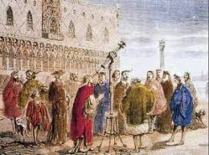
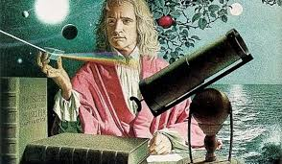
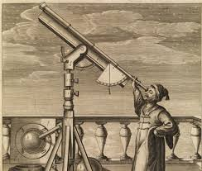
Scientific Revolution

Slide 2
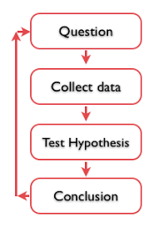
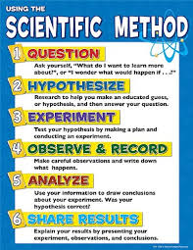
The scientific method was used to solve problems and prove theories

Slide 3
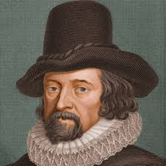
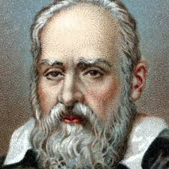
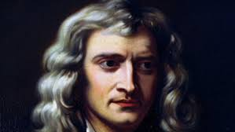
Francis Bacon, Galileo, and Isaac Newton promoted the idea that knowledge should be based on Observation and Experimentation

Slide 4
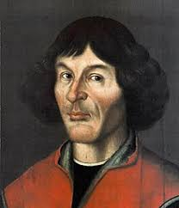
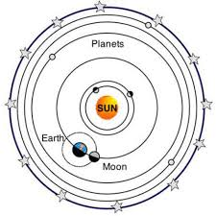
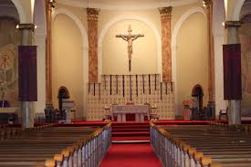
Copernicus' views were contrary to the Holy Church

Slide 5
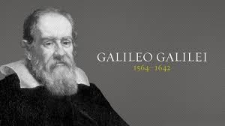
Galileo and other scientists were tried for heresy and excommunicated if they refused to retract their statements.

Slide 6
The works of many scientists and philosophers of the Scientific Revolution and Enlightenment era were similar because they examined natural laws governing the universe.

Slide 7
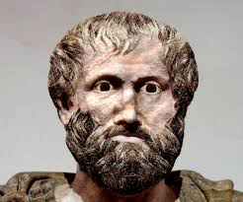
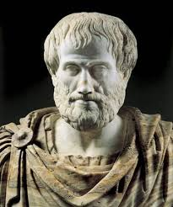
Aristotle's ideas were overturned because evidence was now used to prove theories.

Slide 8
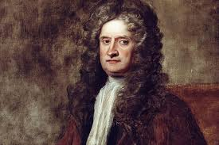
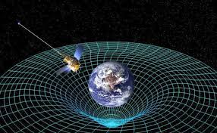
Newton was responsible for the discovery of gravitational force

Slide 9
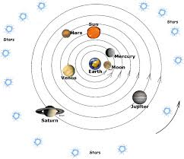
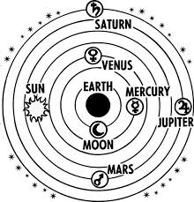
The Catholic Church believed in the geocentric theory of the universe that the Earth is the center of the universe and all planets and stars rotate around it.

Slide 10
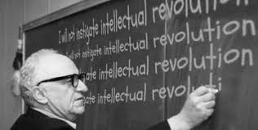
The Scientific Revolution was an Intellectual Revolution

Slide 11
The Catholic Church became less powerful during the scientific Revolution because evidence had proved many scientific theories of the Church false.

Slide 12
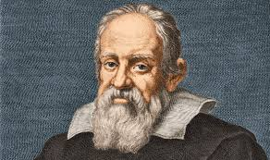
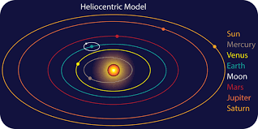
Galileo was punished because the Heliocentric Theory went against traditional Church beliefs.

Slide 13
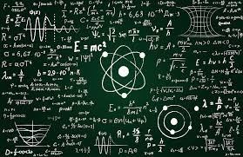
Scientific theories are based on reason and evidence.

Slide 14
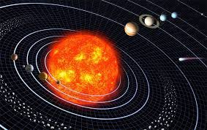
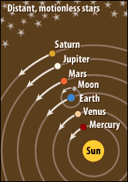
The sun is at the middle of the solar system and all planets and stars rotate around it is called the heliocentric theory

