Slide 1
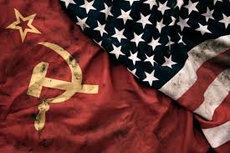
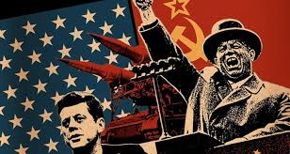
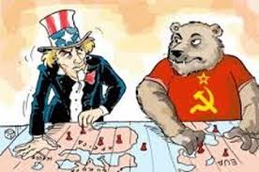
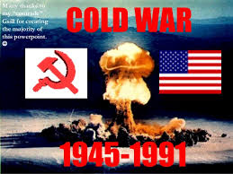
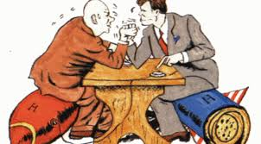
The cold war test review

Slide 2
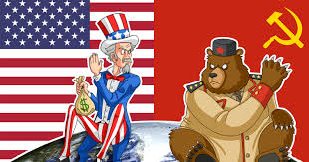
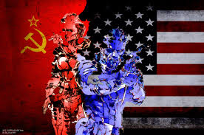
After wwii, The United States and the Soviet Union emerged as an international superpowers.

Slide 3
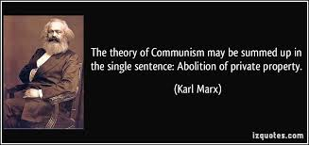
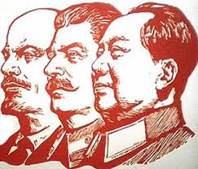
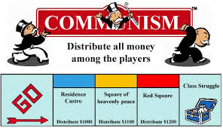
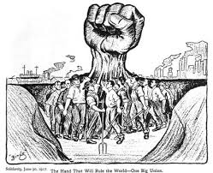
the economic theory of communism is that the Government owns all property.

Slide 4
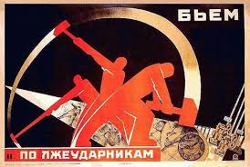
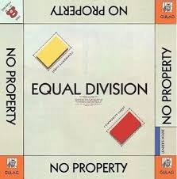
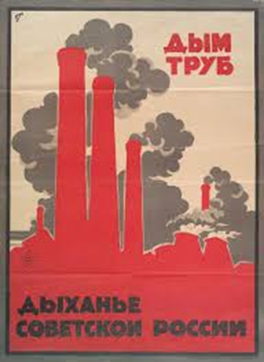
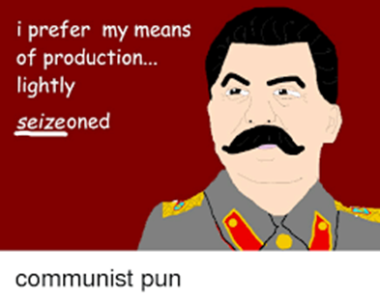
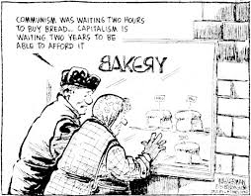
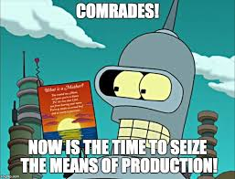
in a communist economy, The government is responsible for producing goods.

Slide 5
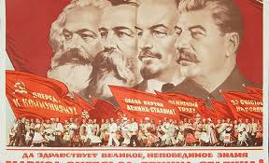
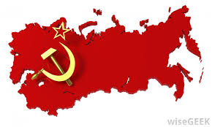
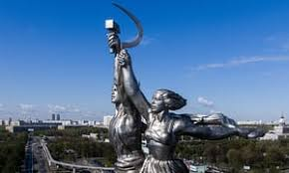
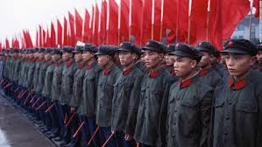
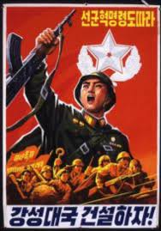
Under a communist government people are required to put the interests of the state (government) before individual gain.

Slide 6
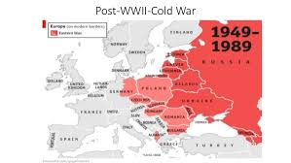
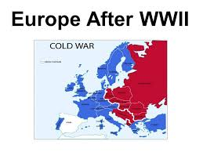
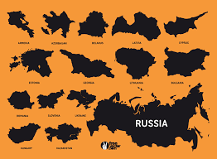
After World War II the Soviet Union wanted to maintain control of many Eastern European nations to extend communist power.

Slide 7
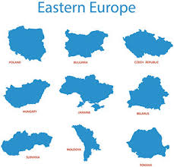
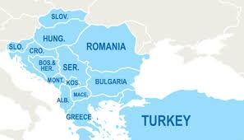
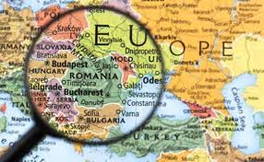
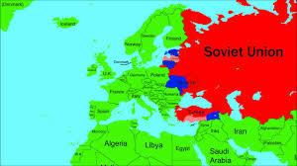
Eastern Europe was most influenced by the Soviet Union In the 30 years after World War II.

Slide 8
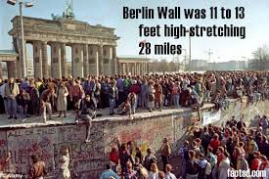
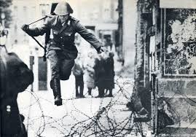
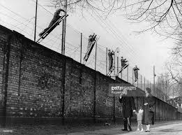
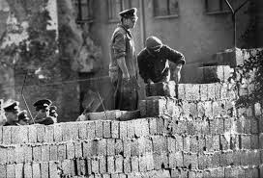
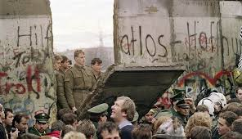
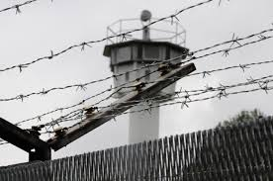
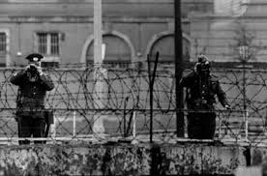
The Communist government of East Germany tried to prevent people from defecting over the berlin wall to West Germany.

Slide 9
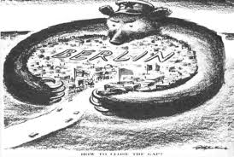
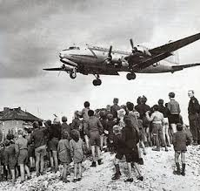
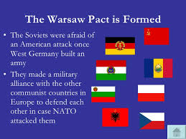
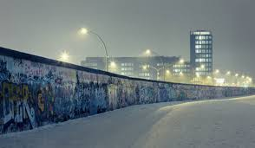
A few Situations that increased tensions between communists and democratic nations in Europe
Blockade of Berlin
Operation of the Berlin Airlift
Organization of the Warsaw Pact
Construction of the Berlin Wall

Slide 10
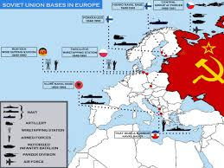
one major goal of the Soviet Union was to create a barrier or defensive zone in Eastern Europe.

Slide 11
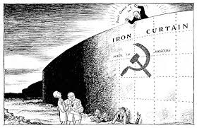
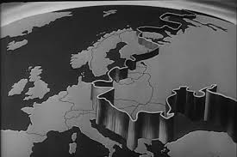
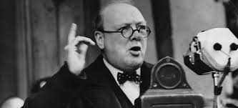
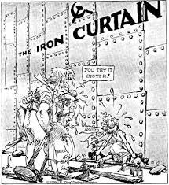
Winston Churchill’s speech about an iron curtain descending upon eastern Europe was about expanding soviet influence.

Slide 12
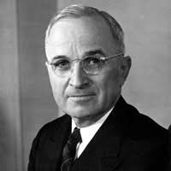
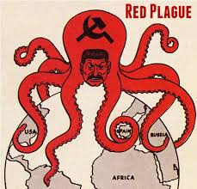
the Truman Doctrine and the North Atlantic Treaty Organization (NATO) were created by the United States because There was a communist threat after World War II.

Slide 13
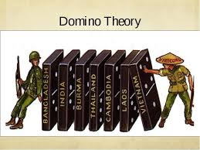
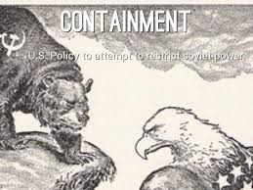
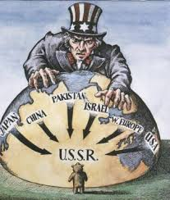
Containment means to Stop communism from spreading.

Slide 14
the purpose of the Marshall Plan was to Provide for economic recovery (Money) to help European countries rebuild after WWII .

Slide 15
the Soviet Union formed the Warsaw Pact because it was a response to the United States and its allies forming NATO.

Slide 16
Space Race
the United States and the Soviet Union engaged in a competition to see who had the best technology in space.

Slide 17
Wwiii almost happened in October, 1962
the Cuban Missile Crisis was when the Soviet Union put nukes in Cuba which threatened the U.S. because Cuba is very close to America and a missile could reach the U.S. quickly.

Slide 18
the Cold War Era never became hot because there was the potential for global nuclear destruction.

Slide 19
The High cost of maintaining the arms race was a negative aspect of the Cold War Era for the soviet union.

Slide 20
The Cold War lasted from 1945 until 1991.

Slide 21
Or did it???????????????????????

