Slide 1
The Scientific Revolution
Your name | Teacher’s name | School

Slide 2
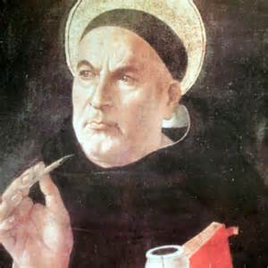
During the Middle Ages, the Christian thinker Thomas Aquinas showed that Christianity and reason could work together.
Notes:
This is the question that your experiment answers

Slide 3
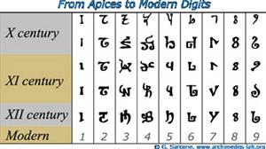
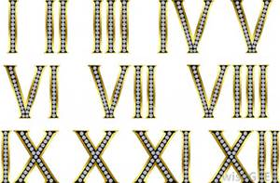
During the Middle Ages, the Hindu-Arabic system of numbers replaced Roman numerals.

Slide 4
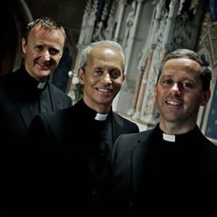
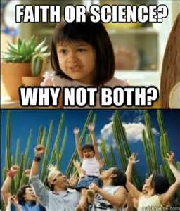
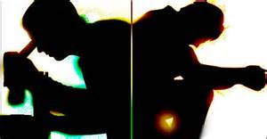
The Catholic clergy denied new scientific knowledge of European scientists in the early 1400’s.
Notes:
Summarize your research in three to five points.

Slide 5
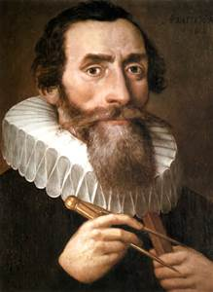
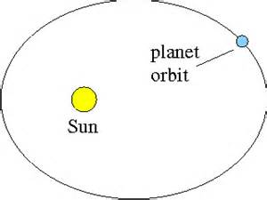
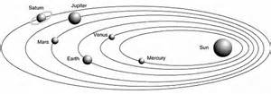
Johannes Kepler proved that planets move in oval paths.
Notes:
Write hypothesis before you begin the experiment. This should be your best educated guess based on your research.

Slide 6
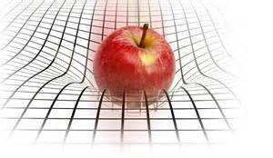
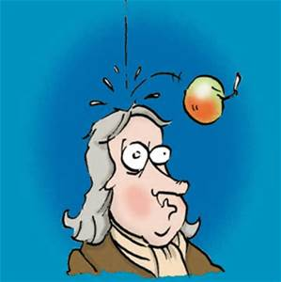
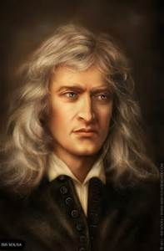
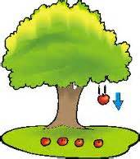
Gravity is the pull of the Earth and other bodies on objects at or near their surfaces

Slide 7
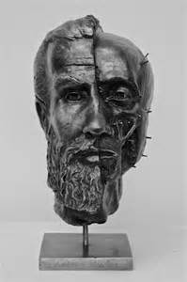
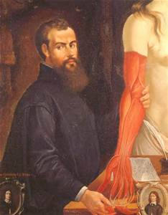
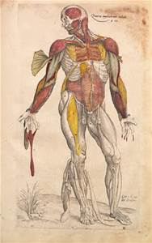
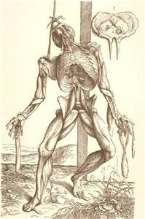
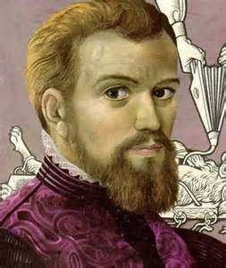
Andreas Vesalius made discoveries about the human body by cutting open dead human bodies.

Slide 8
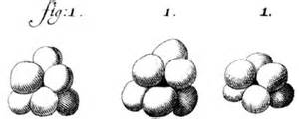
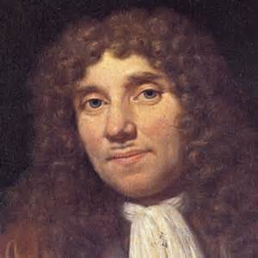
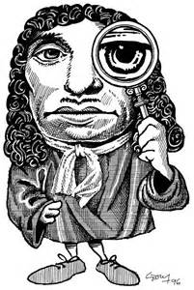
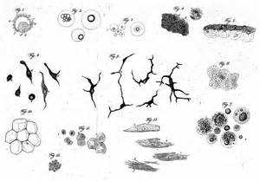
Antonie van Leeuwenhoek discovered tiny organisms called bacteria.

Slide 9
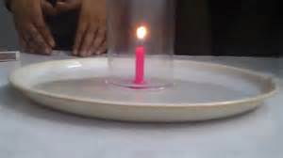
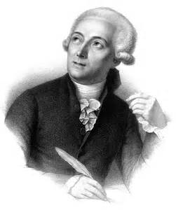
Antoine Lavoisier discovered that materials need oxygen to burn.

Slide 10
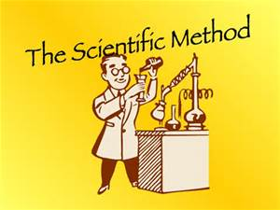
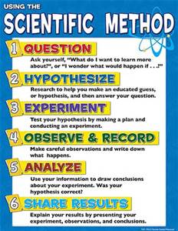
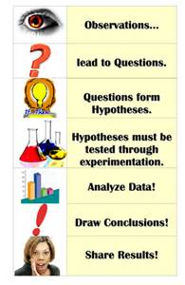
The correct order of steps used in the scientific method is to observe facts; form hypothesis; test hypothesis; develop scientific law.

Slide 11
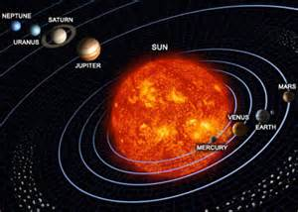
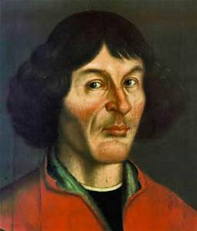
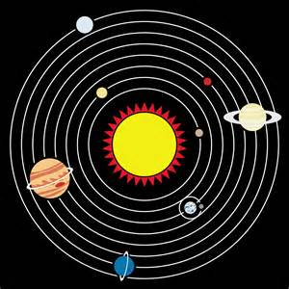
An Sun-centered theory of the universe is called heliocentric.

