Slide 1
WWI

Slide 2
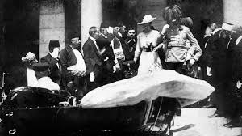
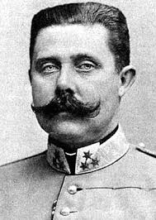
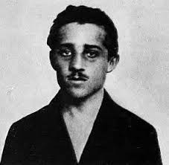
The assassination of Archduke Franz Ferdinand was the spark that lit the powder keg, beginning World War One

Slide 3
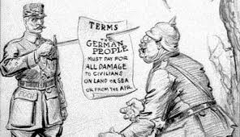
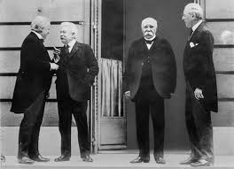
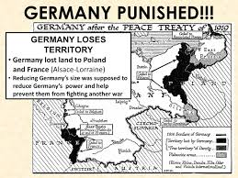
The Treaty of Versailles ended World War I

Slide 4
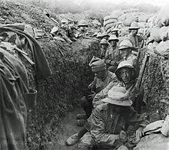
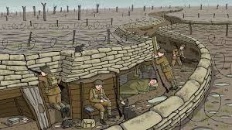
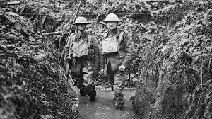
Most of the fighting in World War I was in a small area because trench warfare does not allow for a lot of movement

Slide 5
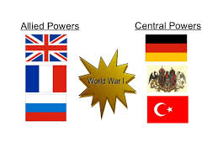
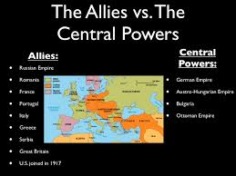
France, Great Britain, and later the United States were known as the Allied Powers

Slide 6
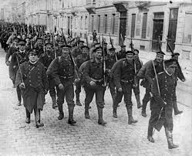
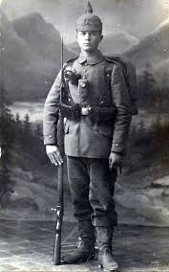
A major goal of France and Great Britain at the peace treaty conference at the end of WWI was to make sure Germany could not rebuild its military strength

Slide 7
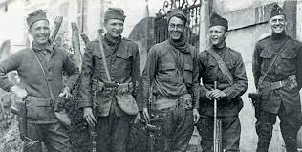
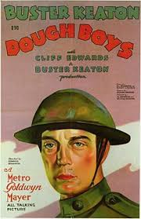
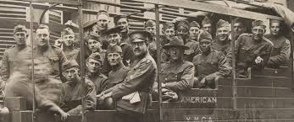
The Americans entered World War One with fresh troops and supplies helping out the British and French

Slide 8
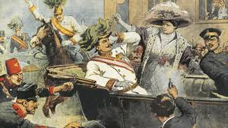
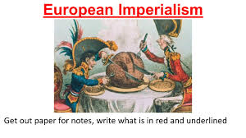
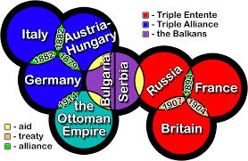
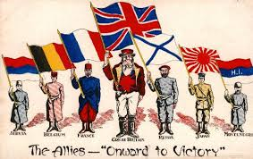
All reasons for WWI
The assassination of Archduke Franz Ferdinand
The creation of military alliances
The buildup of nationalism in European countries
The spread of imperialism throughout the world

Slide 9
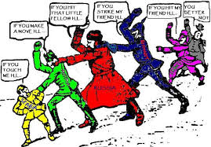
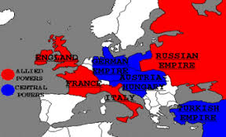
The existing alliances dragged nations into the war. Nations felt obligated to defend their allies, leading to their inclusion in the war.

Slide 10
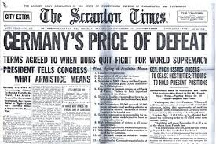
Germany was harshly punished at the end of WWI and blamed by the Allies for starting WWI.

Slide 11
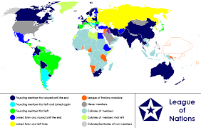
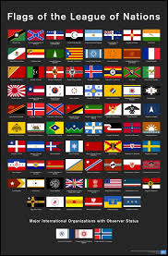
The League of Nations was created after World War One as an international, world wide peace keeping organization

Slide 12
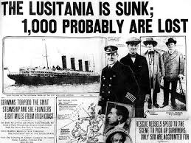
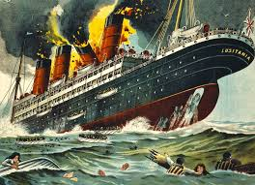
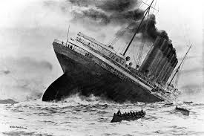
The sinking of the Lusitania made Americans angry.

Slide 13
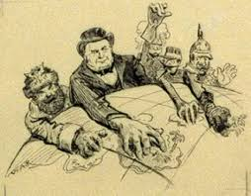
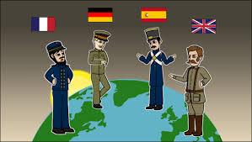
The competition to go to and take other lands and countries in order to gain more raw materials for industry and new markets is known as Imperialism

Slide 14
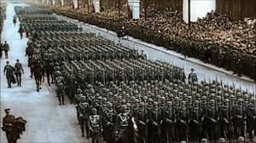
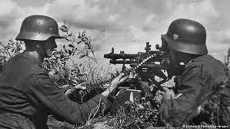
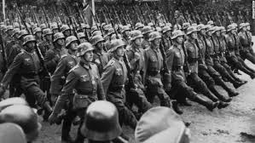
A major goal of France and Great Britain at the Treaty of Versailles following World War I was to Keep Germany from rebuilding its military forces

Slide 15
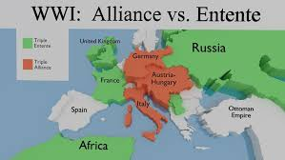
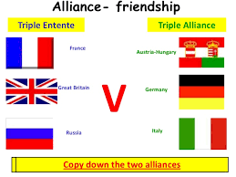
During the period from 1900 to 1914, European political leaders believed that peace could best be maintained by a system of alliances

Slide 16
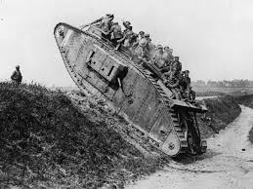
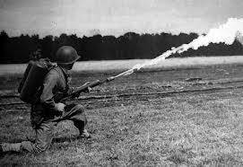
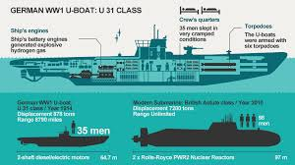
Many technological developments were used during WWI such as tanks and flamethrowers.

Slide 17
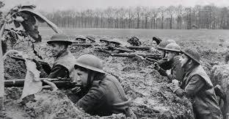
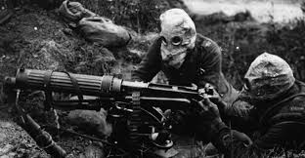
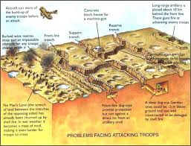
The nature of warfare during World War I on the Western and Eastern Fronts can best be described as a war of attrition or stalemate fought primarily in trenches

Slide 18
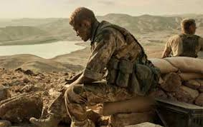
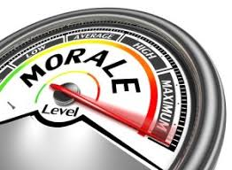
Many troops had low morale

Slide 19
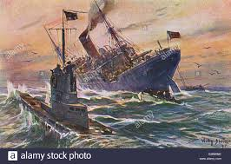
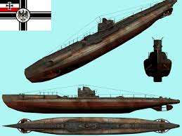
Loss of lives of United States citizens on the Lusitania was blamed on unrestricted submarine warfare by the Germans

Slide 20
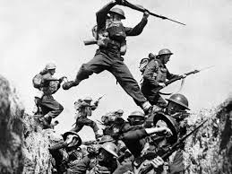
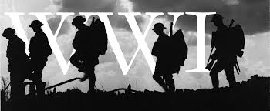
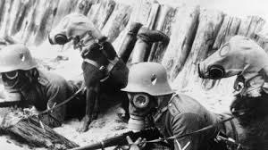
Archduke Franz Ferdinand is assassinated --> World War I begins --> Lusitania sunk --> US declares war on Germany

Slide 21
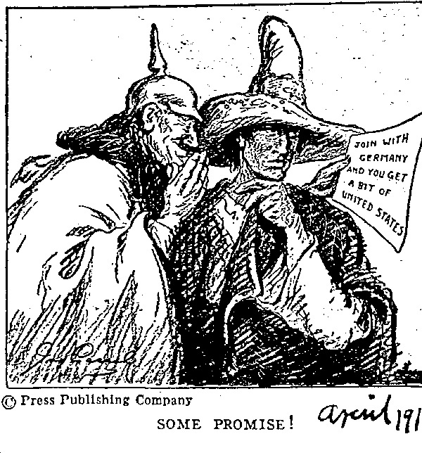
The Zimmerman Telegram was sent by Germany to Mexico to try to have them attack the U.S.

Slide 22
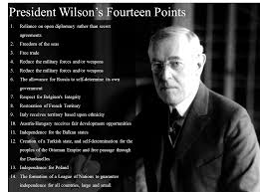
The most significant difference between the Treaty of Versailles and Wilson’s Fourteen Points was Wlson’s14ponts ddnt want to punish Germany.

Slide 23
Trench warfare often lengthened the length of battle

