Slide 1
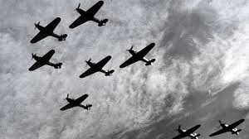
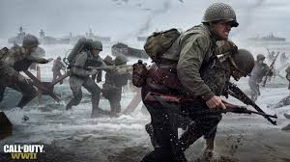
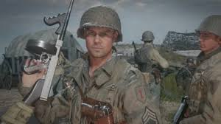
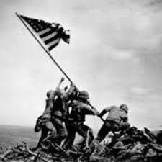
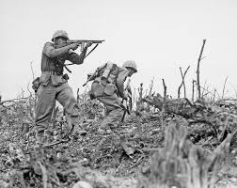
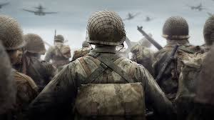
WWII Test Review

Slide 2
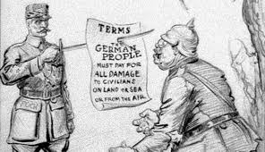
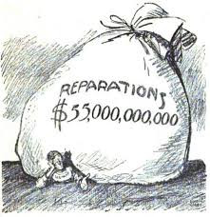
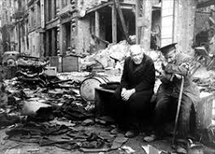
Britain and France helped write the Treaty of Versailles after they had won WWI and said that Germany should have to pay reparations which led to economic and political instability in Germany.

Slide 3
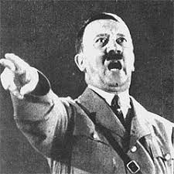
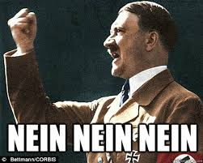
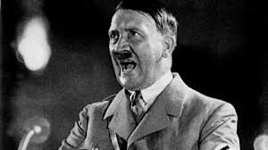
Hitler used German anger towards the Treaty of Versailles to gain power.

Slide 4
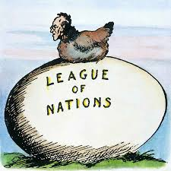
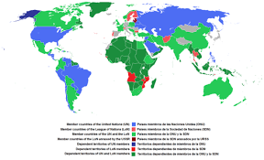
One reason for the outbreak of World War II was the ineffectiveness of the League of Nations.

Slide 5
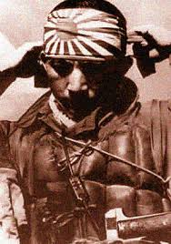
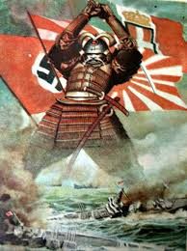
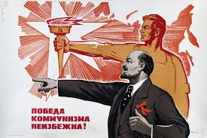
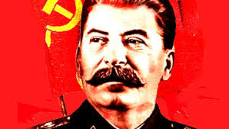
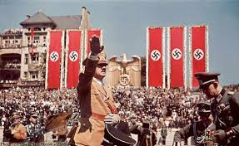
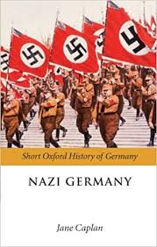
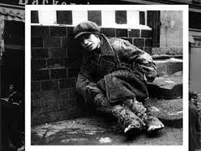
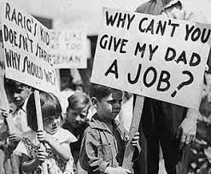
One way fascist (totalitarian) leaders in the 1920s and 1930s gained popular support was by appealing to national pride, especially since countries were in depressions or worsening economic conditions.

Slide 6
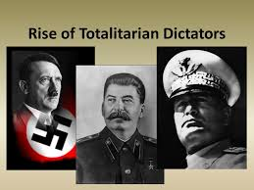
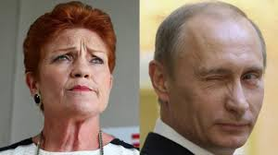
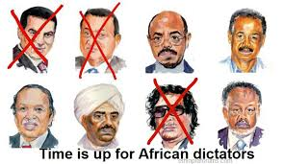
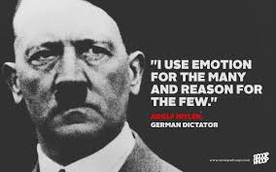
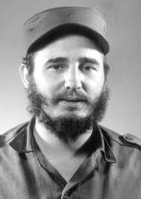
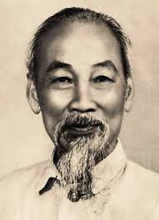
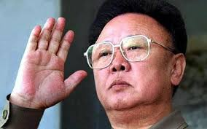
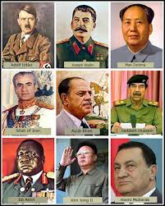
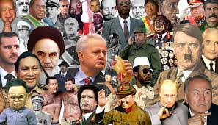
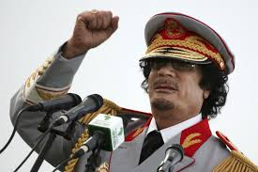
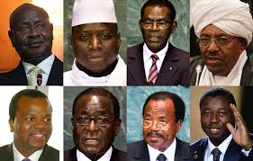
Totalitarian governments had power held by one leader.

Slide 7
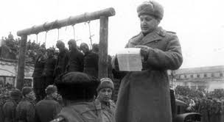
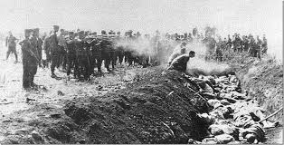
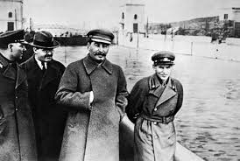
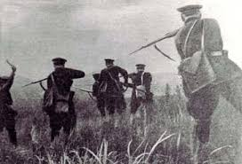
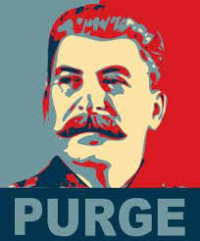
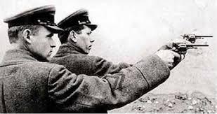
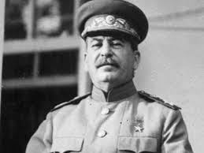
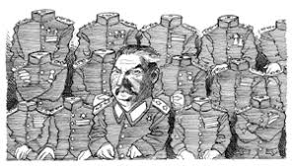
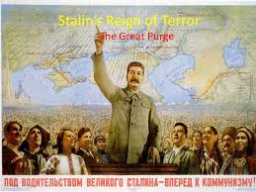
Stalin’s “Great Purge” from 1934-1939 brought about the death of millions of his own people.

Slide 8
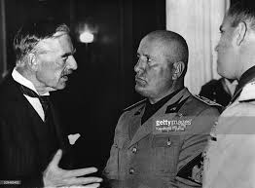
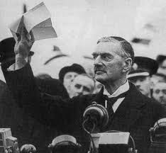
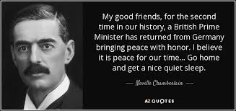
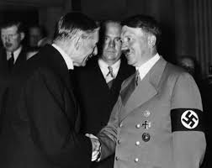
Prime Minister Chamberlain gave in to Hitler’s demands or appeased him in order to avoid further conflict and potential war.

Slide 9
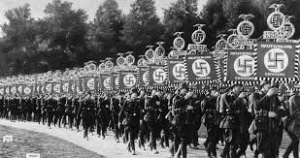
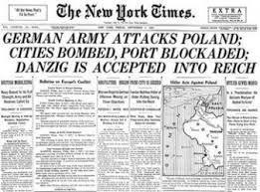
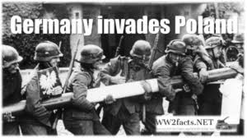
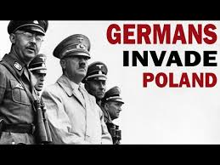
In September 1939, France and Great Britain declared war on Germany, starting World War II in Europe, because Germany’s army invaded Poland.

Slide 10
Order of Events
The Treaty of Versailles is signed, Adolf Hitler becomes Chancellor of Germany, German troops invade Poland.

Slide 11
Extreme Nationalism was expected out of citizens of Nazi Germany.

Slide 12
The holocaust was planned in great detail and required the cooperation of many people.

Slide 13
Because the holocaust was a genocide and a violation of human rights and crimes against humanity, certain Nazis were tried for war crimes in Nuremburg.

Slide 14
Horrific acts can be committed by an advanced society regardless of time period.

Slide 15
A major justification used by Japan for extending into Asia and empire building in the 1930s-1940s was to imperialize by obtaining food and raw materials that it lacked.

Slide 16
Japan’s bombing of Pearl Harbor brought the United States into WWII.

Slide 17
People were encouraged to conserve food and fuel so that the military could use it.

Slide 18
Germany, Italy, Japan were the major Axis Powers.

Slide 19
The Dropping of the atomic bombs on Hiroshima and Nagasaki killed 70,000 instantly and over 100,000 later on by radiation poisoning causing cancer.

Slide 20
The principal defense used by most Nazis tried at Nuremburg after World War II was that they were following orders given by their leaders. Those personally responsible for war crimes against humanity were hung.

Slide 21
The violence and destruction that occurred during World War II led to the formation of the United Nations.

